Slide 1
SLC Waste & Recycling Division Services
Programs and Operations
Frank Young
Supervisor
David Johnston
Permits Coordinator

Slide 2
What We Do
Weekly Pick-up Services
Call 2 Haul
Container Maintenance
Public Education & Outreach
Special Events Recycling
Construction and Demolition Diversion
Business & Multifamily Unit Recycling

Slide 3
Weekly Pick-up Services
Programs
Refuse
Recycle
Green-waste
Range
Entire City Limits
1850 Lane Miles
110 Square Miles

Slide 4
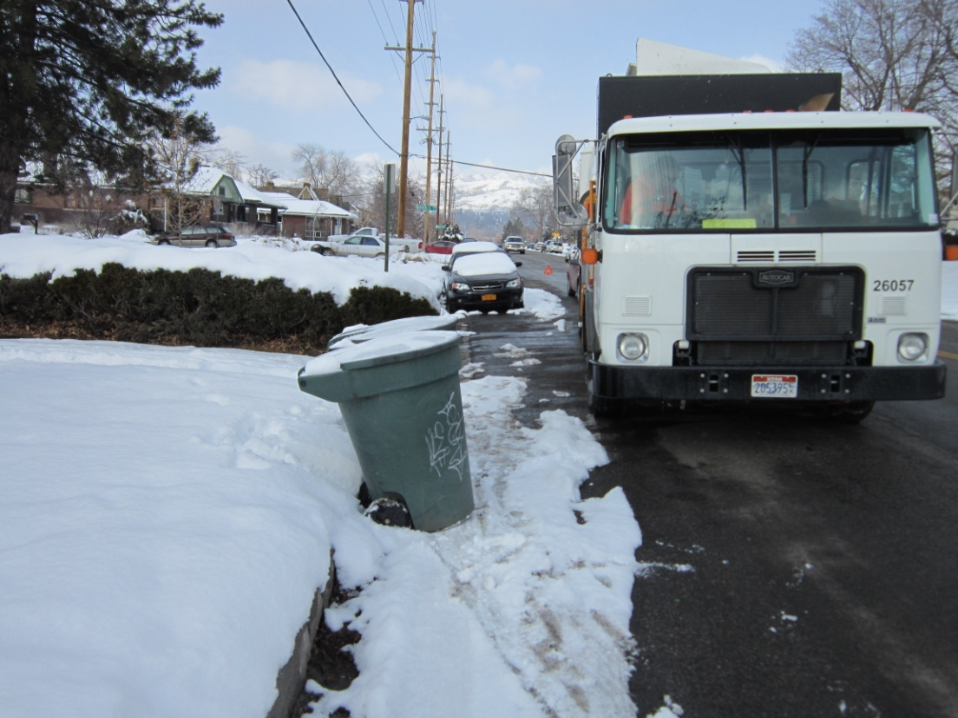
Weekly Pick-Up Services
Equipment
Sanitation Trucks
26 CNG (2018 purchase price $326,00)
8 DIESEL (2018 purchase price $282,000)
Maintenance
Annual Maintenance budget $1,413,789
Fuel
Total Fuel cost $257,000
CNG $107,000
Diesel $150,000
Personnel
31 Full-Time Operators
Miles driven
Total 380,000
Miles driven in one year equal 15 trips around the Earth

Slide 5
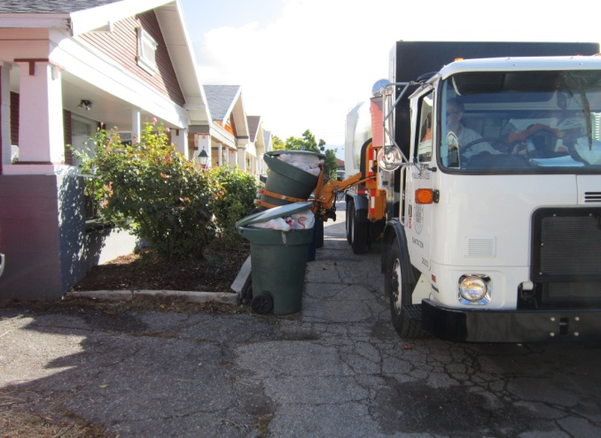
Refuse
Routes
55 total
11 Per Day
Drivers
11
Trucks
14
Customers
40,000 accounts
2018-1,868,126 containers emptied
8,000 Homes Per Day
Can Collected Per Truck
800-1000 *Per Day (Peak season)
Waste Collected Per Truck
20-30 tons*
Trucks Miles
50*

Slide 6
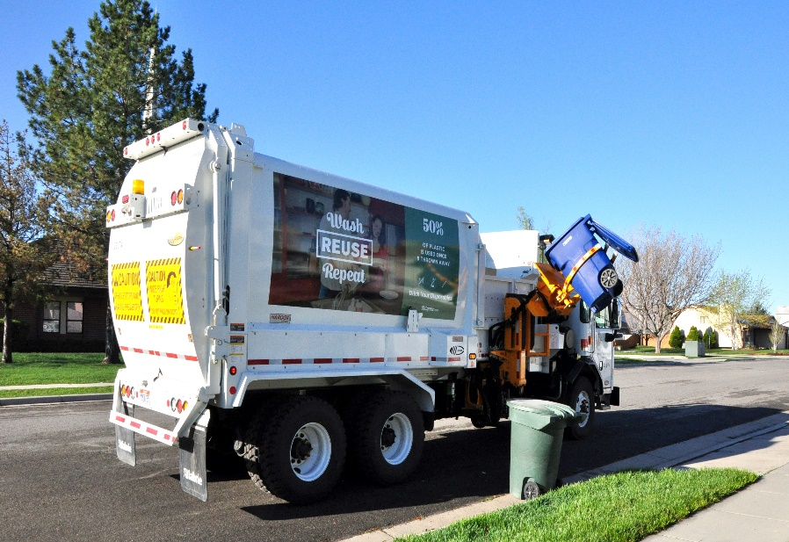
Recycle
Routes
40 Total
8 Per Day
Drivers
8
Trucks
11
Customers
40,000 accounts
2018-1,545,651 containers emptied
8,000 Homes Per Day
Can Collected Per Truck (Peak season)
800-1000* Per Day
Recyclables Collected Per Truck
6 -8 Tons* Per Day
Trucks Miles
50-60* Per Day

Slide 7
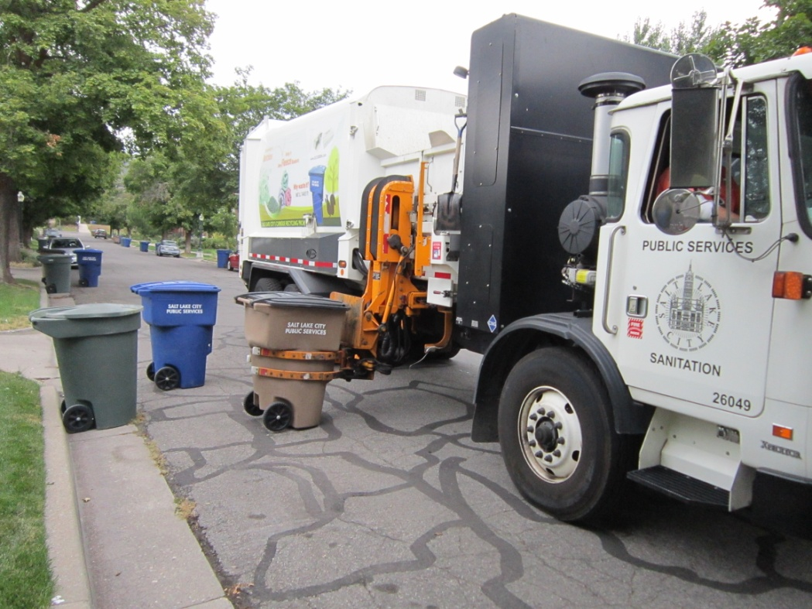
Green-waste
Routes
40 total
8 Per Day
Drivers
8 per Day
Trucks
11 total
8 Per Day
Customers
40,000 accounts
2018-662,407 containers emptied
Can Collected Per Truck
400-700* Per Day (Peak Season)
Green Waste Collected Per Truck
20-30* Tons Per Day (Peak Season)
Trucks Miles
50-70* Per Day

Slide 8
Weekly Pick-Up
Special Services
Yard Service
Call Back Services
Private Streets collection
One-way street collection
Lead truck
5679 Christmas tree collected
YW trucks-2744
Curb-side -2935
All city operated Parks, Golf Courses & Facilities

Slide 9
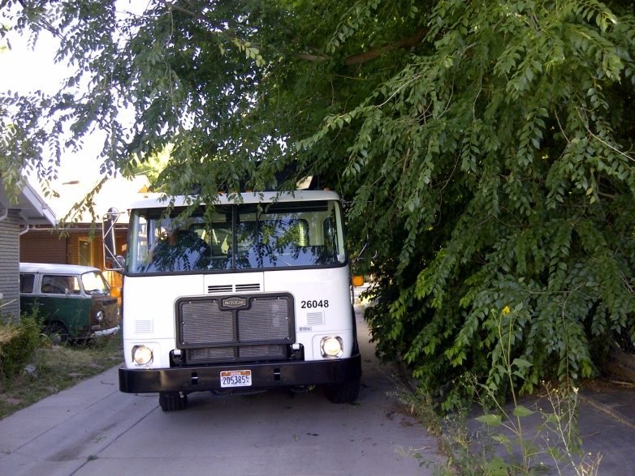
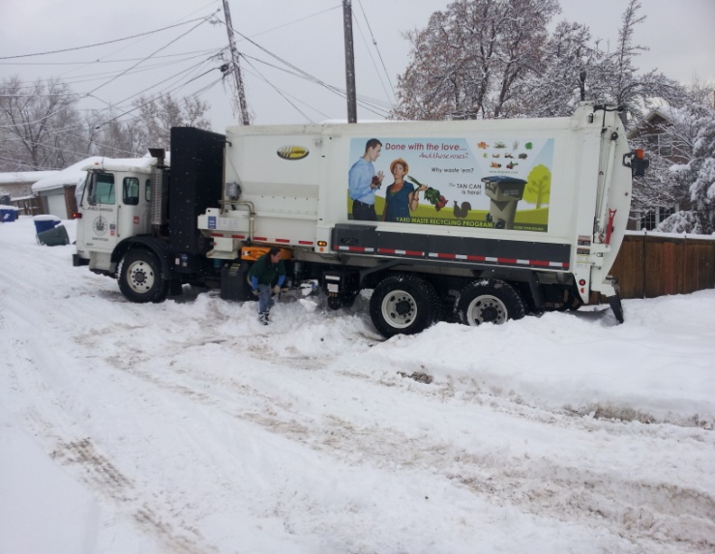
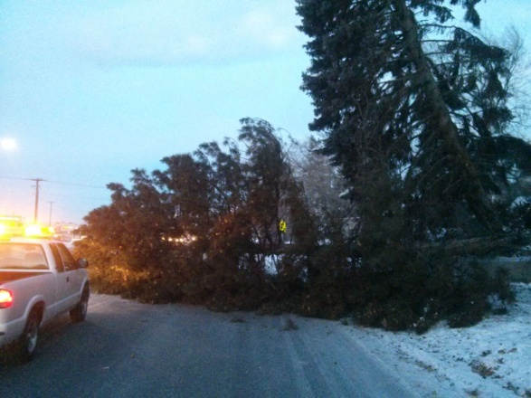
Adverse conditions

Slide 11
Recycle

Slide 12
Green-waste

Slide 13
Call to Haul
The Call 2 Haul program started July 1, 2018 and is available year-round.
Residents can schedule 1 collection per year.
A wider variety of materials are accepted with increased waste diversion!
Using Call 2 Haul
Determine what type of bulk items you would like to have collected by the City.
Call (801) 535-6999 Monday–Friday, 8 a.m. to 5 p.m. to schedule your customized pickup. You will be asked the following questions:
a. What sort of materials do you have for pickup?
b. How much?
You will be offered several pickup options, which will be weekly windows.
The City will call and email to confirm the exact day of your scheduled pickup, at least 24 hours in advance.
Once you receive confirmation from the City, put your waste on the parking strip or curb to be collected.
Waste cannot be placed on the curb more than 24 hours in advance.
That’s it! We’ll collect your waste on your scheduled day and recycle or dispose of it appropriately.
Notes:
A wider variety of materials are accepted with the new service!
Electronic waste, such as TVs, computers and mobile phones
Tires (up to 4)
Scrap metal and appliances will be appropriately recycled
Mattresses will continue to be recycled.

Slide 14
Call 2 Haul
Accepted Materials
Bulk item(s)
Green waste
Green waste must be too large to fit in the compost container
No dirt, grass, sod, roots or leaves will be accepted through Call 2 Haul.
New! - Electronic waste, such as TVs, computers, printers, phones, stereos etc.
New! - Up to 4 tires
What materials are NOT accepted?
Any material that can fit into existing containers
Construction material
Household hazardous waste, such as paints, pesticides, oil, fluorescent lights, batteries and other chemicals
Flammable or explosive material, such as aerosol cans, gas cans, propane tanks, etc.
Any amount of dirt, sod, rocks, concrete or asphalt
Notes:
Bulk item(s) includes items such as furniture, mattresses and appliances – mattresses and appliances will be recycled but most furniture will not – so if its usable furniture make sure you are donating it to the a thrift store.
Construction material
Private haulers should be contacted for construction/demolition debris or large clean-out projects, large trees should be hauled away be a contractors as well

Slide 15
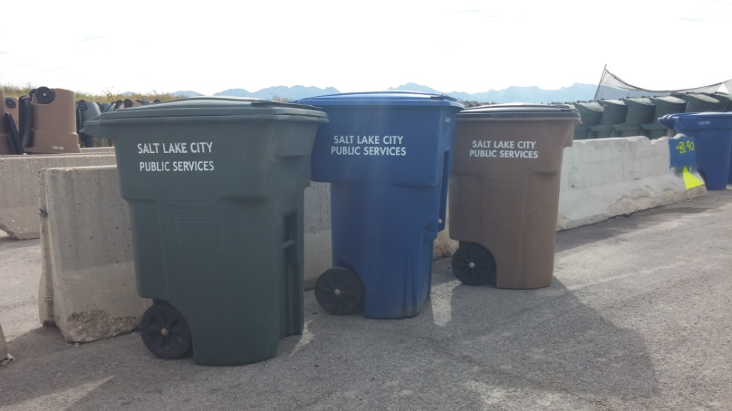
Container Maintenance
Employees
3 Full Time
2 Seasonal
Trucks
5 CNG Flat Bed Trucks
Containers In Service – 129,625 ($6,481,250)
46,849 Refuse containers
41,273 Recycle containers
41,503 Yard-waste containers
Containers Services Per Year
13,962
Average service attempts 25 per day
Special Services
Delivered 2340 additional green-waste container
Special Events
125 Special Events
4757 containers
Transported & Washed

Slide 16
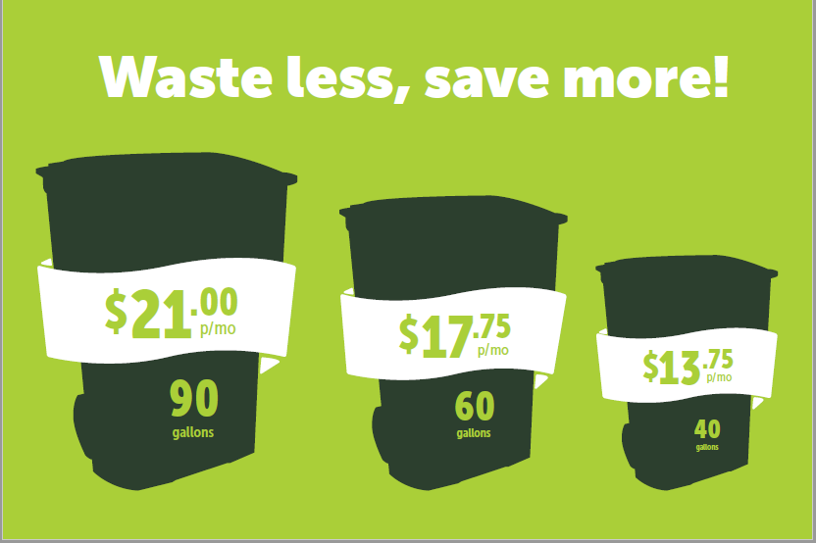
SLC Downsizing Campaign

Slide 17
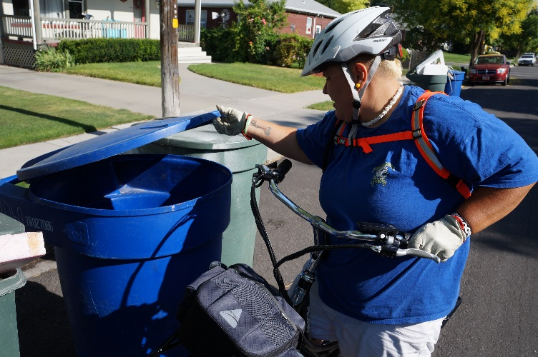
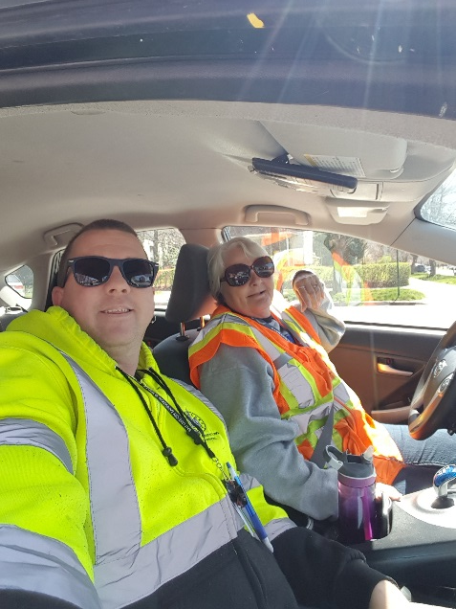
Education
2018 Can Audits:
275,593 Recycle
84,147 Yard-waste
4,645 Tags
2018 Door to Door:
2,822 Contacts Made

Slide 18
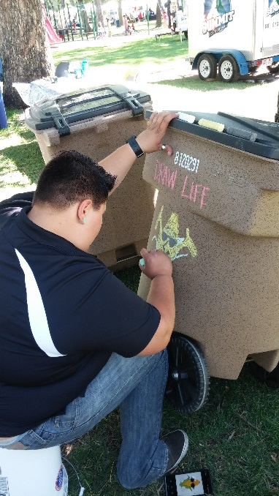
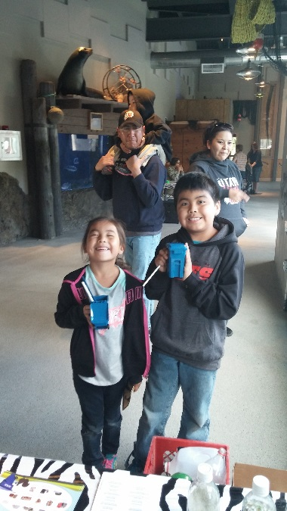
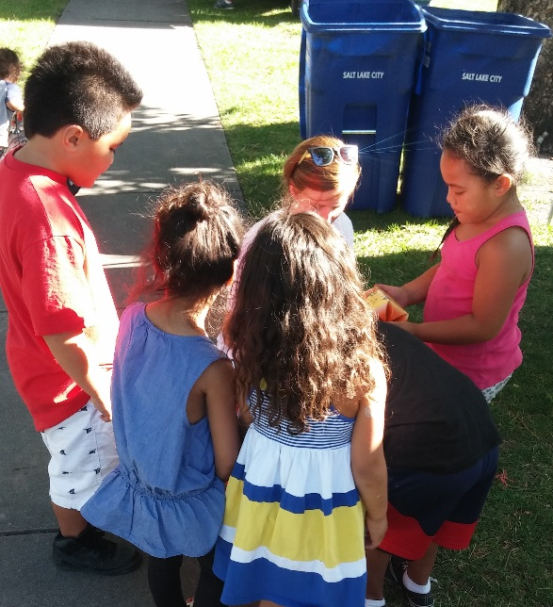
Education
2018 Events YTD:
4 E-Waste/Pharmaceuticals
(Collection Events)
24 Community Events

Slide 19
Waste Reduction Through Permitting
Three Permitting Agendas:
Special Events
Reduction, Recycling, Litter Control
Post Event Bin Checks and Auditing
Construction and Demolition Permitting
55% minimum diversion through salvage, reuse, recycling, etc.
Business and Multi-Family Recycling Ordinance
Recycling required of many businesses/apartments as of January 1st, 2018

Slide 20
Special Events 2018 By The Numbers
518 (+4% vs. ‘17) special event permits processed
233 events required waste management plans
125 events serviced by SLC Waste & Recycling (+23% vs. 2017)
2,402 trash cans (+16.9% vs. 2017)
2,355 recycle cans (+14.3%)
8 compost cans

Slide 21
Special Event Waste/Recyclables

Slide 22
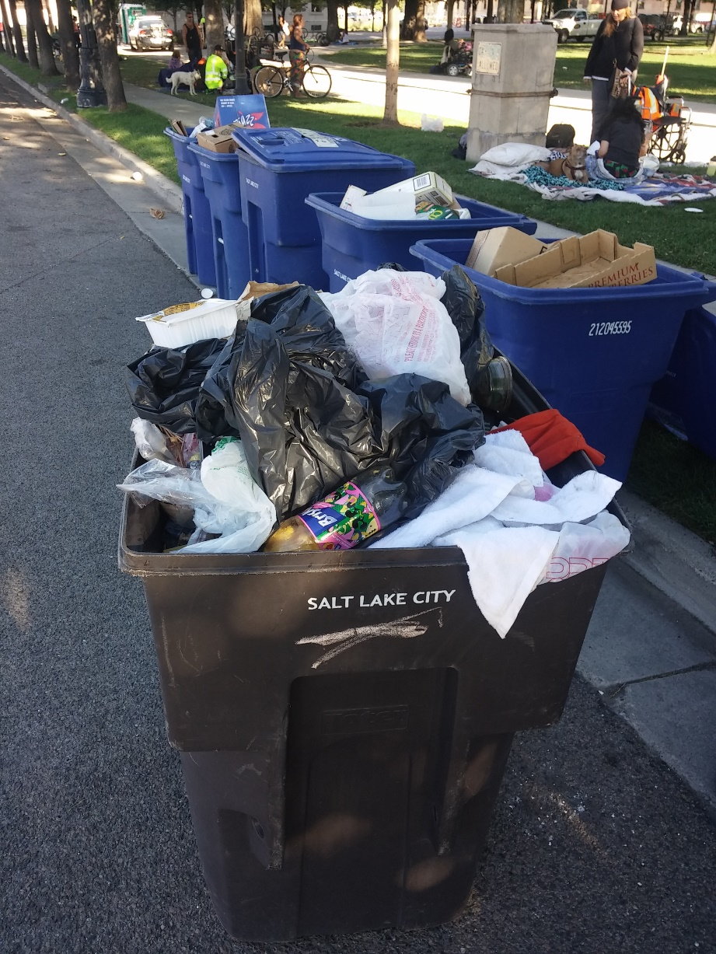
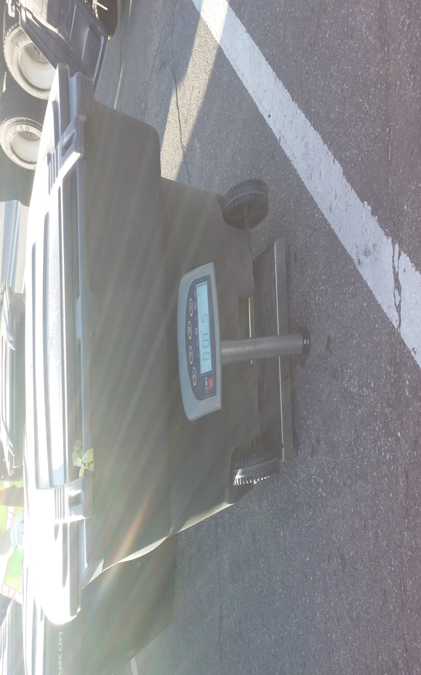
Bin Checks & Waste Audits

Slide 23
SLC Waste & Recycling Muscle

Slide 24
2015 Utah Pride Festival Audit

Slide 25
What we found from this audit:
Close to 55%+ of disposed materials could have been recycled.
Large amounts of:
Cardboard
Plastic (All grades)
Aluminum
Glass
Plastic Film
Food waste & other non recyclable materials made up the 45%

Slide 26
Waste Signage Revisions

Slide 27
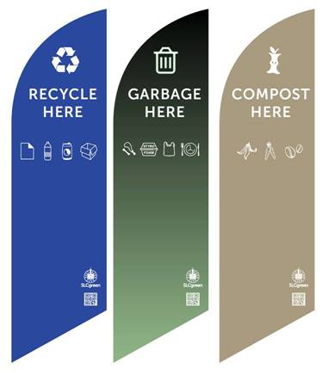
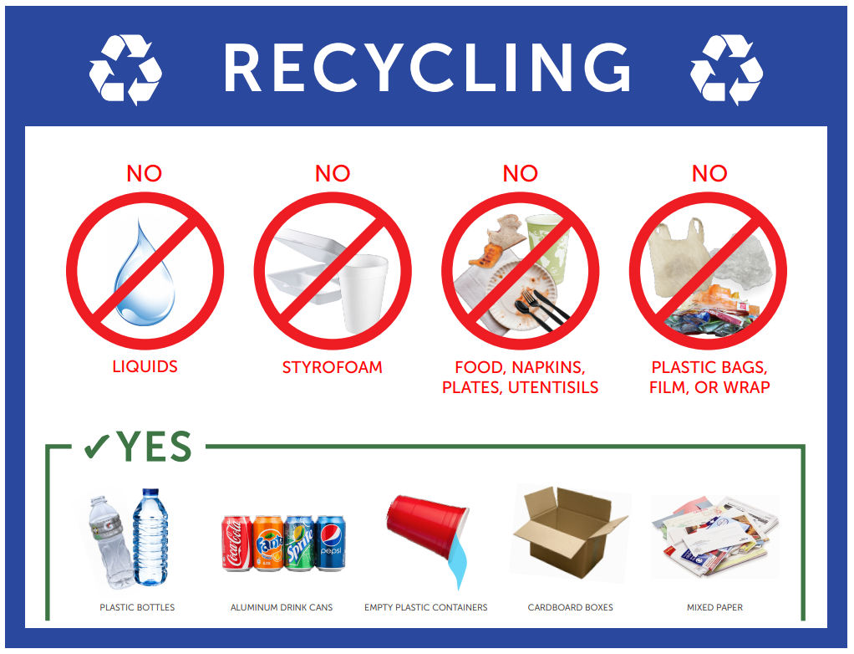
Waste Signage Revisions

Slide 28
C&D Recycling & Diversion
According to city code, C&D Waste Management Plans are required of:
New construction of multi-family developments with three or more dwelling units
New subdivision developments of over twenty (20) single-family homes
All new mixed-use and non-residential development that exceed 5,000 square feet
The demolition of a principal structure, and any expansion
Alteration or modification that increases the existing development’s gross floor area by at least 1,000 square feet

Slide 29
C&D Recycling & Diversion
As SLC continues to develop and densify, construction & demolition waste remains prevalent
Most common ‘waste’ materials include
Concrete/Brick/Rock
Asphalt
Metal
Clean wood
Green waste
ALL of these materials are highly salvageable, reusable, recyclable

Slide 30
C&D Recycling & Diversion
Many local recyclers that will accept these materials:
Rocky Mountain Recycling
ACE
Waste Management
CRI
Bland Recycling
Eco-Pan
Huish Materials LLC
Wind River Recycling
Momentum Recycling
North Point Recycling
Wasatch Metal
Western Metals
Utah Metal Works
Metro Group
Midvale Recycling
Redwood Recycling
George’s Architectural Salvage
Habitat For Humanity’s ReStore

Slide 31
C&D Recycling & Diversion
C&D Waste Management Plans require demonstration/description of:
How 55% of the waste will be salvaged and recycled or reused
Methods to reduce total waste generated by the project
Training of project site team to ensure proper recycling & reuse
Total amount and types of waste reused, recycled, or composted and what amount and types of the waste will be taken to the Landfill
Names of haulers and names of facilities where waste materials are to be taken
Two Parts of C&D Waste Permit
Preemptive Plan (WMP) & Post-Project Report (WMR)
Report is actual documentation of diverted waste

Slide 32
C&D Recycling & Diversion 2018 By The Numbers
Total approved projects:
60 construction, 60 demolition plans
2018 Incoming WMP’s:
Average estimated waste diversion is 71%
96% projects able to plan for 55% or more diversion
2018 Incoming WMR’s:
Average actual waste diversion is 64%
94% projects actually met 55% or more diversion
Project managers that fell short were all followed up with, helped plan for improvement on future projects
Construction projects diverting ~10% more than demo

Slide 33
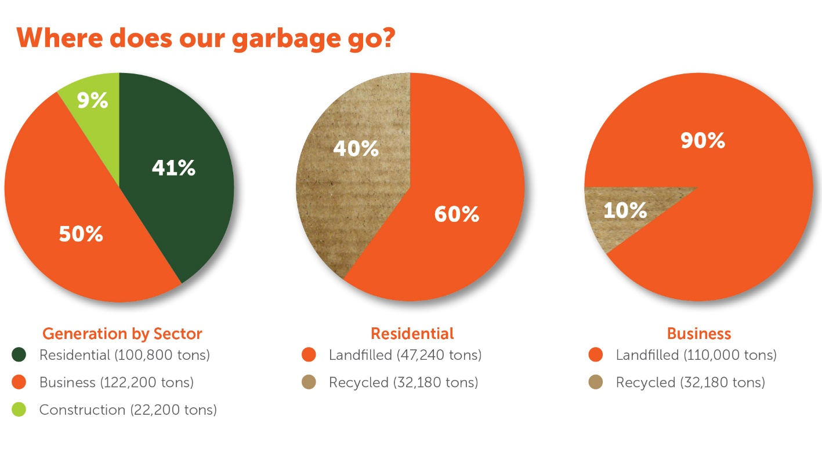
Business & Multifamily Recycling SLC Ordinance 9.08.200
Passed January 4th, 2016; Enforced January 4th, 2018
Why bother with businesses?
When in full effect, 9.08.200 will help divert 20,000+ tons

Slide 34
Business & Multifamily Recycling SLC Ordinance 9.08.200
Compliance required of businesses, offices, multifamily residential properties generating 4+ yd³ of weekly waste
Applicable generators can only use city-authorized waste haulers, who are required to submit quarterly reports detailing:
Total tonnages of recyclables and green waste diverted from landfill to MRFs and other facilities
Total tonnages of garbage sent to landfills
# of accounts subscribing to recycling and/or green waste services, plus # of accounts generating 4+ yd³ total waste each week
Any info about non-compliance by generators

Slide 35
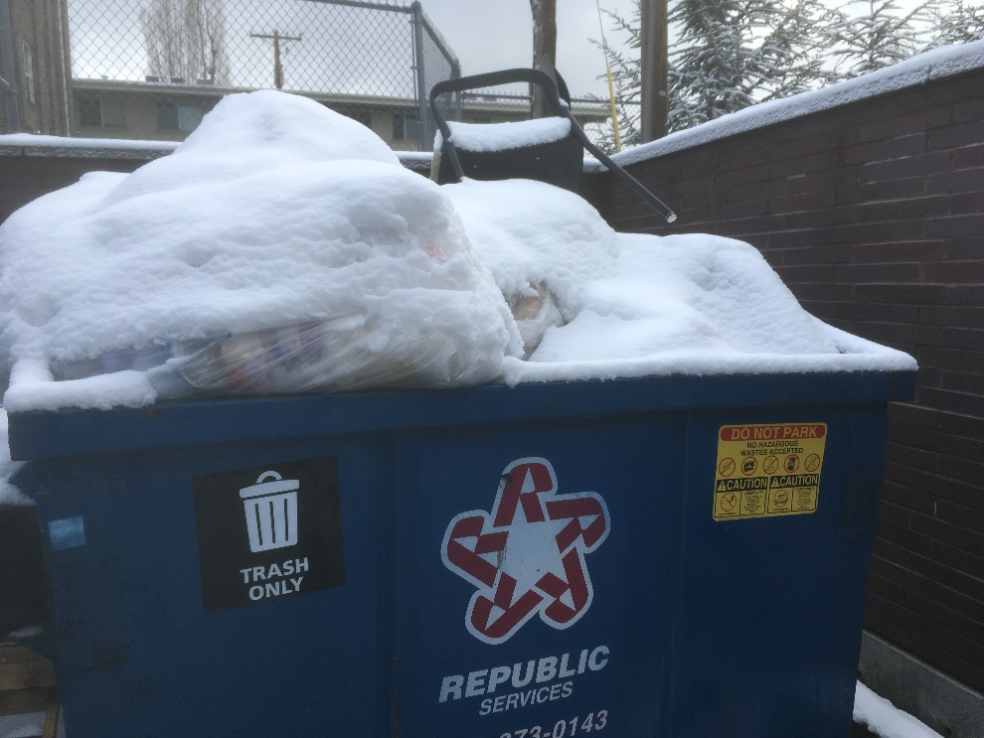
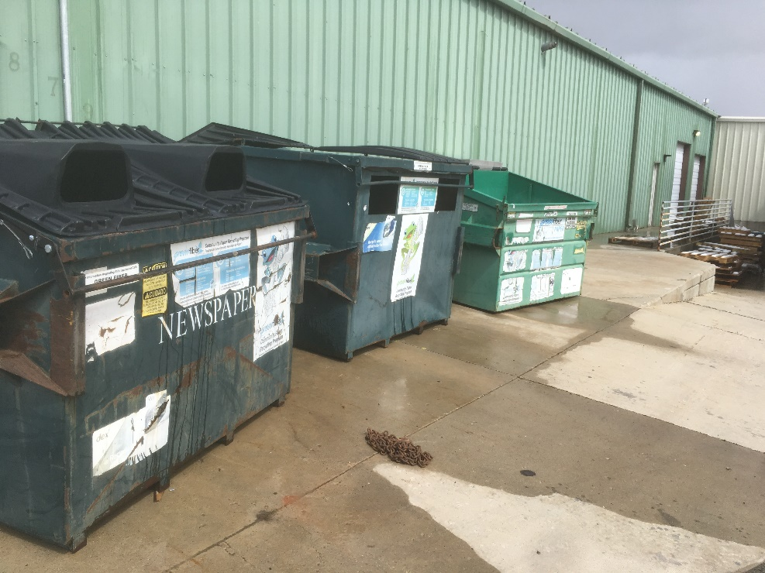
Business & Multifamily Recycling: Site Visits & Setting Up A Plan
“(1) Subscribe to recycling service or green waste service with an authorized hauler capable of diverting fifty percent (50%) of the solid waste and recyclable items generated, by volume, and use an authorized hauler to provide solid waste and recycling collection service”
Do they have equal sized dumpsters/containers for garbage and recycling?
Are they contracted with a city-authorized hauler for these services?

Slide 36
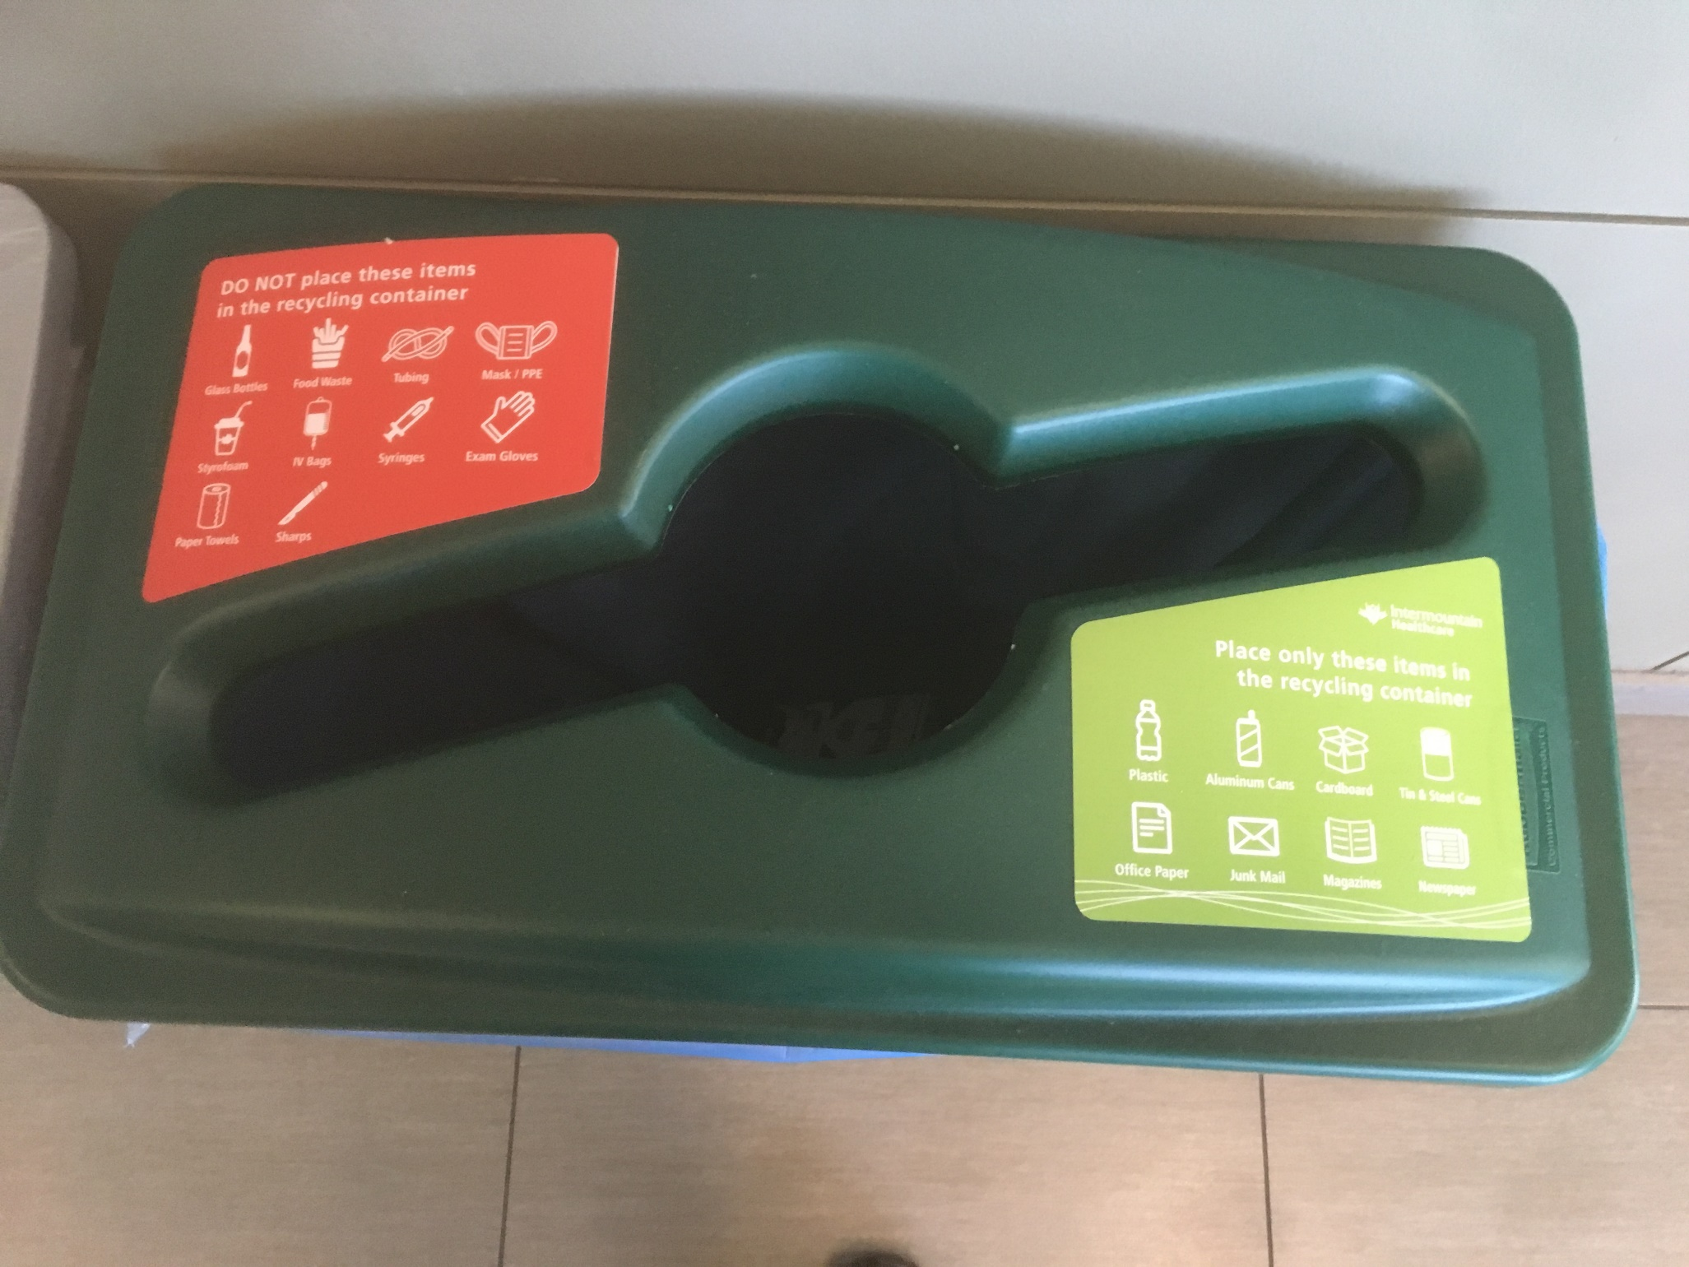
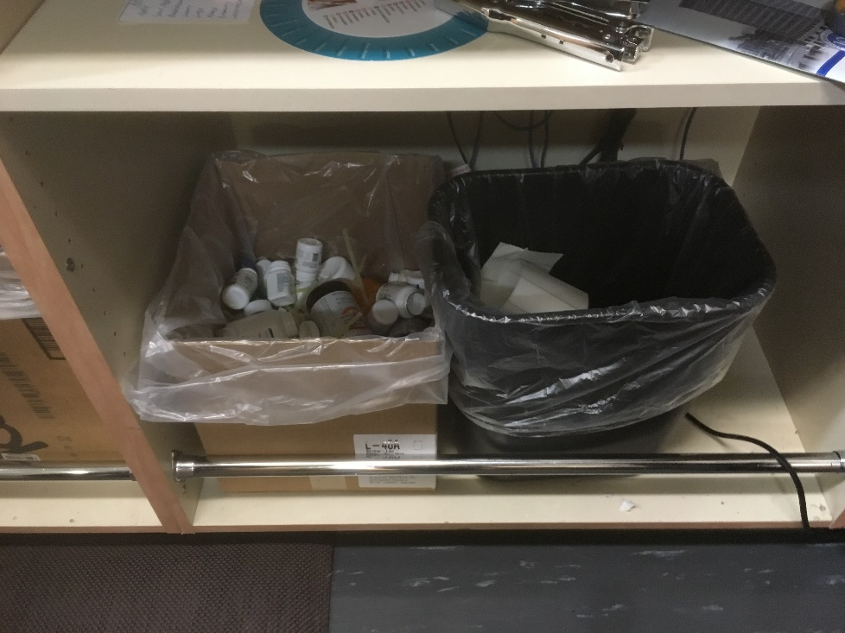
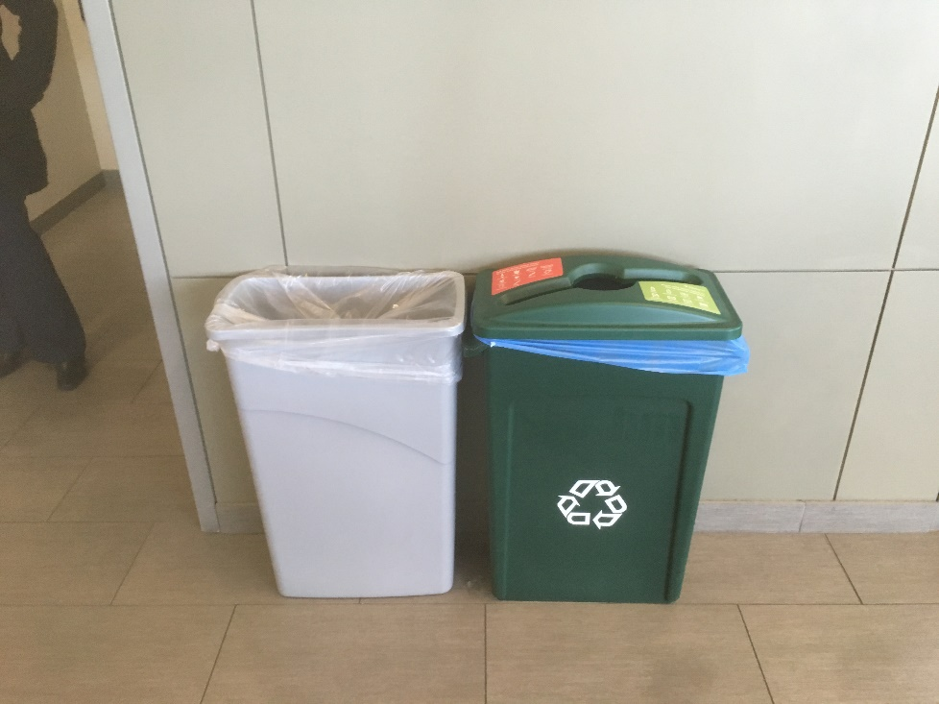
Business & Multifamily Recycling: Site Visits & Setting Up A Plan
c. Designate areas and provide recycling containers for use by occupants, employees or residents that are as convenient to use as refuse containers. d. Prominently post and maintain one or more signs in maintenance or work areas or common areas where recyclable items are collected or stored that specify the materials to be source separated and the collection procedures for such materials.
Is recycling just as, if not more, convenient than throwing something in the trash?
Can tenants, employees and guests easily understand what is or is not recyclable?

Slide 37
QUESTIONS?

