Slide 1
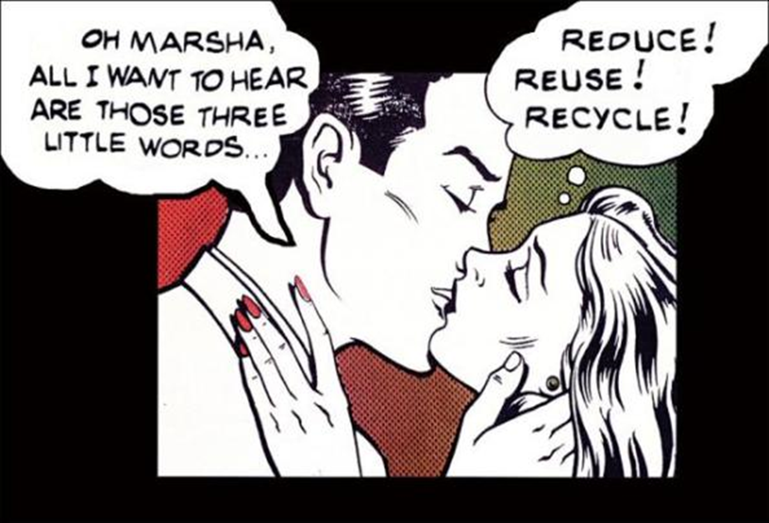
Waste & Materials Management II
Notes:
In Waste and Materials Management 1 we talked about our waste stream, what we do now and what has historically been done with ‘garbage’. We talked about why landfilling and incinerating, for the most part are not solutions for our waste, and we introduced the concept of Zero Waste the shift that occurs when we see our garbage for the materials that they are and learn the best ways to manage those materials.
Our city has a goal to be Zero Waste- maximizing as much recyclable, compostable material as we can by 2040 with a goal of 70% by 2025.
Today, we are going to hone in specifically on Recycling

Slide 2
Today
What is Recyclable
Challenges
Green Purchasing
Outreach Best Practices
Waste Management’s MRF Tour – Yay!
Notes:
Details of exactly what is and isn’t recyclable in Salt Lake.
What sort of challenges we encounter in the recycling world.
You’ll see that the challenges we face directly affect what we can put in our blue cans.
We’ll be talking about Green Purchasing – the options we have as consumers and how our purchases can have a positive effect on the environment and the recycling industry.
Outreach Best practices – essentially- how do we encourage a community to recycle.
If you subscribe to our newsletter on slcgreen.com or follow the blog you will see that we will be getting a new MRF that will be operational in early 2020…

Slide 3
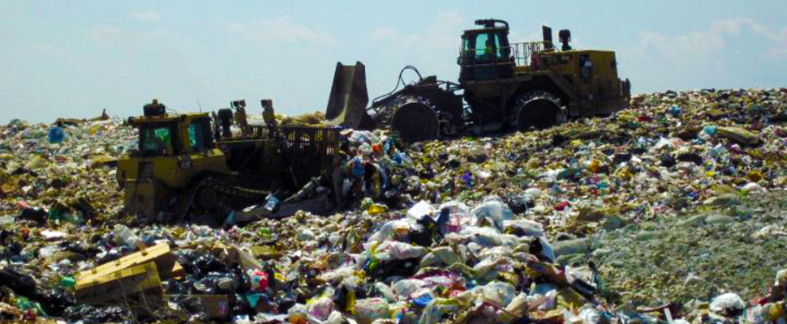
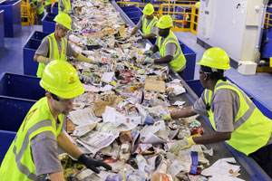
Recycling is Awesome
Energy Savings
Economic Benefits
Resource Conservation
Healthier Ecosystems
Landfill Space
Notes:
Recycling is awesome for a number of reasons…
The Recycling Across America organization states, “Without exception, Recycling is the top action society can do to simultaneously improve: the environment, the economy, sustainable manufacturing and to prevent waste from going into oceans.”
We’ve probably all heard that by 2050 if business goes as usual there will be more plastic than fish in the ocean. This originated from the World Economic Forum in 2017 and is calculated by weight- if you think about how lightweight plastic is… that’s a lot of plastic. It’s estimated that one garbage truck a minute is being dumped into the ocean. 8 million tons each year.
I’ve broken down some of the benefits into similar categories…..

Slide 4
Recycling Efficiency
Impacts of Waste
Energy
Water
Landfill Space
Notes:
Now we are gong to break down the recycling efficiency of some of the basic materials, in terms of three things: Energy, Water, and Space.
With the energy and water we will be looking at the savings from using recycling materials instead of raw or virgin materials; and then the space saved when the materials are recycled instead of landfilled.

Slide 5
Recycling Efficiency Paper
Recycling Savings (per ton)
Energy – 40% Reduction (4,100 Kwh)
Water – 50% Reduction (7,000 gallons)
Landfill Space – 3.3 Cubic Yards
Notes:
You get a 40% reduction in energy used, but the real ‘heavy hitter’ here is the water.
We save 3.3 cubic yards of landfill space per ton.

Slide 6
Notes:
Virgin pulp and paper mills are the largest industrial users of water per ton.
Paper can be recycled into new paper 5-7 times. It depends on the type and quality of paper. Eventually after 5 or more times, the fiber strands get too short and it will have to be mixed with virgin paper or used for other things like egg cartons, bedding, or insulation. This is why you can’t recycle Paper towels, toilet paper and napkins even when clean. They are already made of a really low grade fiber.
Paper is one of the easiest materials to recycle, and 87% of Americans have access to curbside pickup.

Slide 7
Recycling Efficiency Cardboard
Recycling Savings (per ton)
Energy – 24% Reduction (4,100 Kwh)
Water – 50% Reduction (7,000 gallons)
Landfill Space – 9 Cubic Yards
Notes:
Since cardboard is paper, essentially, the huge water savings is the same.
We get a little less savings on energy but triple the savings on space. Cardboard especially when not broken down properly takes up a huge amount of space in a landfill.

Slide 8
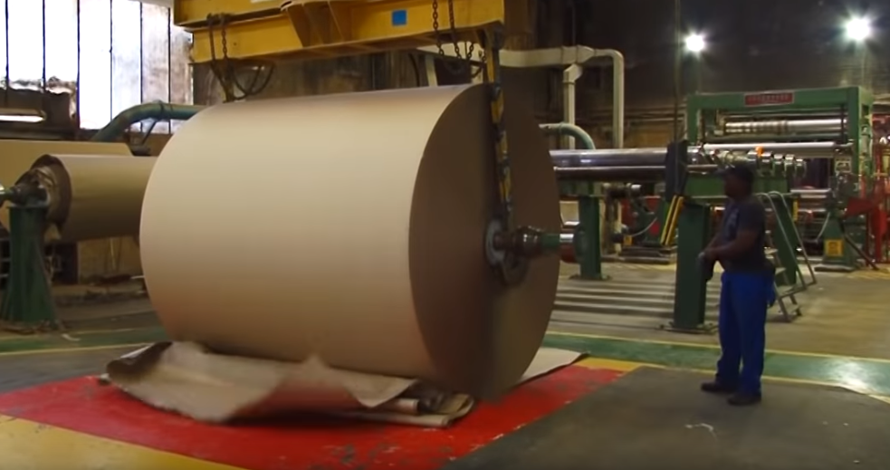
Notes:
Something to note here: cardboard is the biggest contributor to the waste stream at about 12% of all waste; it is also in the top two recovered material for recycling with an 81.3% recovery rate
Cardboard can be recycled many times, a bit more than regular paper because it starts with longer, stronger fibers.

Slide 9
Recycling Efficiency Plastics
Recycling Savings (per ton)
Energy – 90% Reduction (5,700 Kwh)
Oil – 16.3 barrels Reduced
685 gallons crude oil
Landfill Space – 30 Cubic Yards
Notes:
Plastics have huge savings all around…
New plastics will consume 20% of all oil production within the next 35 years,

Slide 10
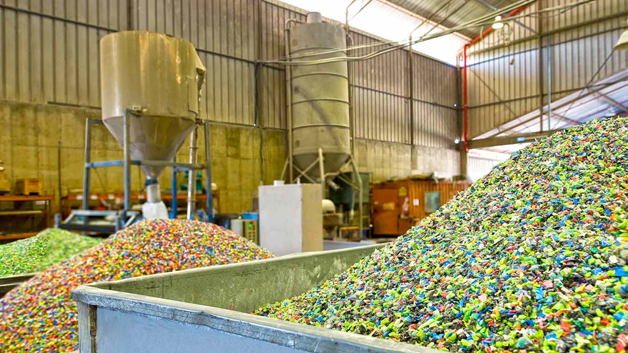

Slide 11
Recycling Efficiency Steel/Iron
Recycling Savings (per ton)
Energy– 74% Reduction (642 Kwh)
Water – 40% Reduction (25,040 gallons)
Landfill Space – 4 Cubic Yards
Notes:
Steel, Iron, Copper can be recycled infinitely without losing quality which makes it really valuable.

Slide 12
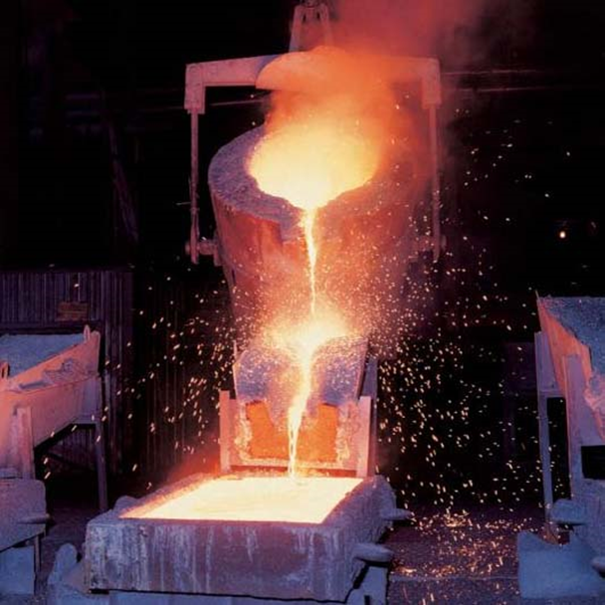
Notes:
Two out of every three tons of steel produced are made from old steel.
Steel also has the highest recycling rates with a 92.5 percent recycling rate of automobiles, a 90 percent recycling rate of appliances, 72 percent recycling rate of steel packaging.

Slide 13
Recycling Efficiency Aluminum
Recycling Savings (per ton)
Energy– 95% Reduction (14,000 Kwh)
Water – 95% Reduction (27,800 gallons)
Landfill Space – 10 Cubic Yards
Notes:
Aluminum is the most valuable of recycled materials

Slide 14
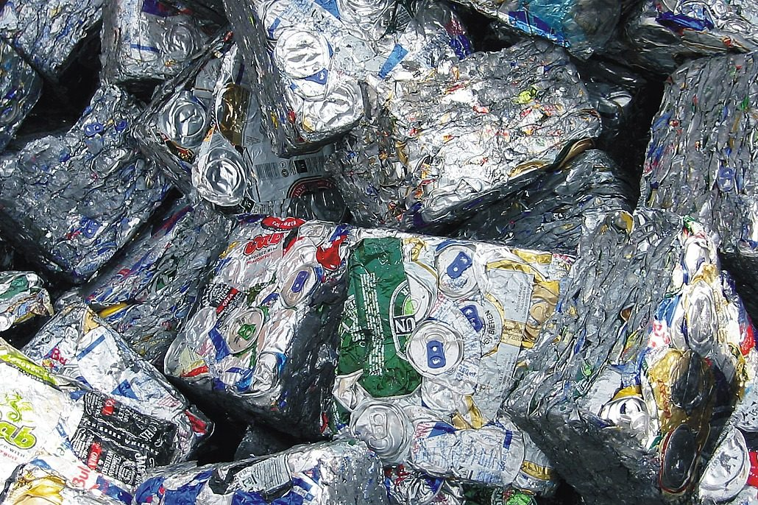
Notes:
It can also be recycled infinitely & has a quick turn around; you could see the same aluminum in a new can in as little as 60 days.
Right now they estimate that 65% of cans in the U.S. are recycled comparatively PET bottles are recycled at 32%
Recycling one aluminum can saves enough energy to listen to a full album on an iPod.

Slide 15
Recycling Efficiency Glass
Recycling Savings (per ton)
Energy – 40% Reduction (42 Kwh)
Water– 50% Reduction (290 gallons)
Landfill Space – 2 Cubic Yards
Notes:
Finally, glass. Although we don’t accept it in the blue bin, You can recycle through Momentum by paying for a glass bin at your house or by taking it for free to a drop off location located throughout the city. The reason we don’t accept it in single stream here is because it degrades the other recyclables specifically paper. If a paper mill knows you accept glass in your curbside recycling it decreases the value of paper.

Slide 16
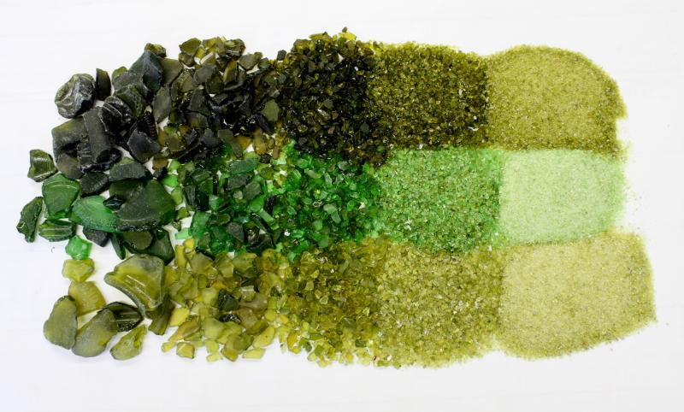
Notes:
I would also add that glass does not decompose-once in a landfill it will be there for a million years.
It can also be recycled infinitely back into glass, depending on the tinting. But it also gets recycled into a lot of longer-term building materials from roadways to insulation.

Slide 17
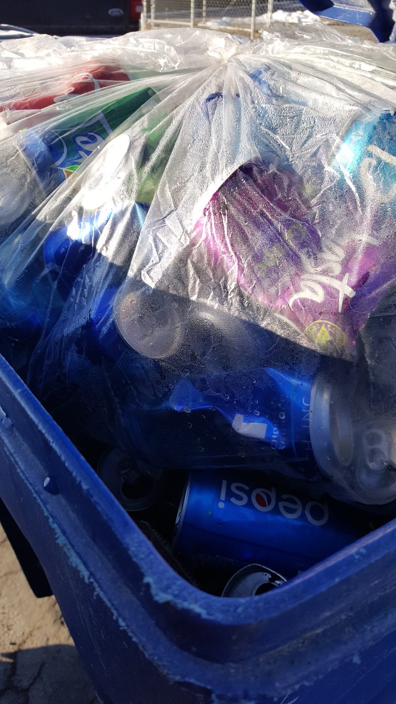
What is Recyclable?
What is Not Recyclable?

Slide 18
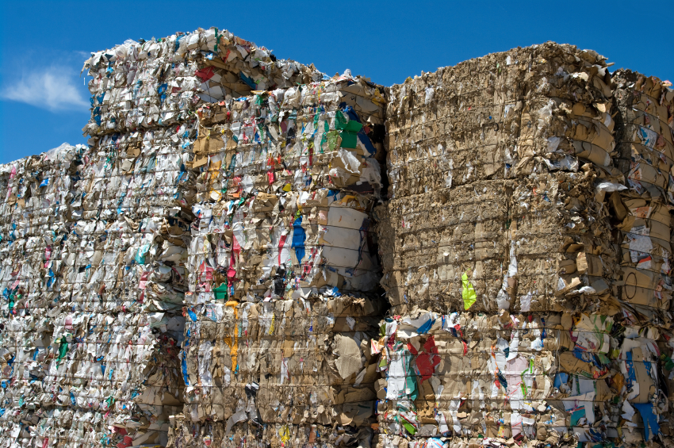
Cardboard, Paperboard & Paper
Notes:
No shred because it is too small to effectively capture/ not contained in bags-plastic or paper.
Clean cardboard

Slide 19
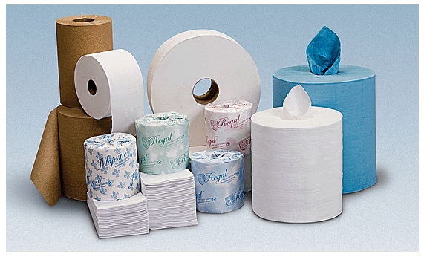
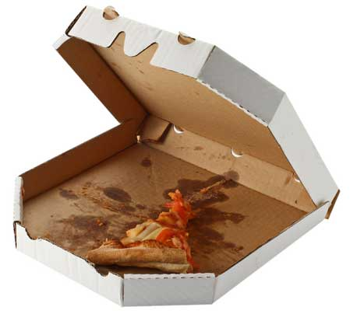
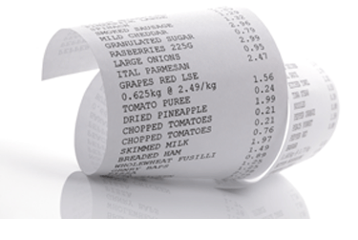
Cardboard, Paperboard & Paper
What is NOT recyclable in the Blue Bin:
Paper towels, tissues, toilet paper (even if they are clean)
Paper coated or soaked with other materials or oils
Pieces smaller than 2”-3” (Includes Shredded Paper)
Most receipt paper (Thermal paper is not recyclable)
Notes:
PT- made of low grade fiber
Pizza boxes – rip off lid
No shred because it is too small to effectively capture/ not contained in bags-plastic or paper.
Receipt paper has a layer of plastic- BPA

Slide 20
Cartons – the “tricky” one

Slide 21
Cartons – the “tricky” one
Notes:
Cartons- such as gable top refrigerated milk and juice cartons.
Not aseptic (thermally sterilized liquid products are packaged into sterilized containers to produce shelf-stable products that do not need refrigeration. Commonly known as Tetra Paks a company founded in Sweden in 1951.

Slide 22
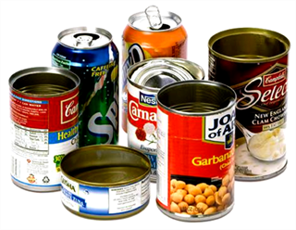
Metals
Recycle all Metal cans
Notes:
Steel, tin, aluminum – do not need to remove label if there is one.

Slide 23
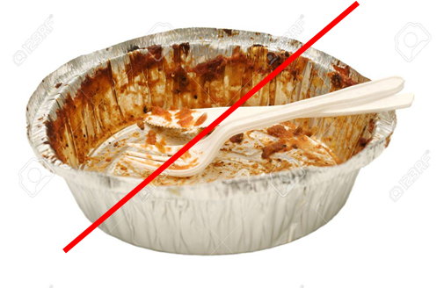
Metals
What is NOT recyclable in the Blue Bin:
Scrap Metal – recyclable at drop-off locations
Metal Hangers – recyclable at drop-off locations
Items smaller than 2”-3”– recyclable at drop-off locations
Batteries – recyclable at drop-off locations
What is truly not recyclable?
Dirty foil
Notes:
Utah Metal works – off of Beck street
Wasatch Metal Recycling in South SL
Western Metals Recycling

Slide 24
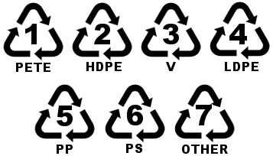
Plastics
Notes:
Recycling arrows aren't generally helpful in knowing what to recycle right now. I saw one of my shirts had a recycling symbol on it. A lot of plastic films on food packaging have the recycling symbol on them. – Meal kit freezer paks. It’s telling you the type of plastic it is made out of not necessarily that it’s recyclable material that belongs in your blue bin.
However it is generally helpful to know recyclables for our own use , yes, but also when purchasing items. We can make better decisions on materials.
Ask when original recycling symbol came to be. 1970- senior college student Gary Anderson submitted to a design contest for continuing growth for consumer awareness and environmentalism for the first Earth Day

Slide 25
Plastics Chart
Plastics | Qualities | Common Usages | WM (Waste Managment) | Safety
1 - PET or PETE Polyethylene Terephthalate | Thin, typically clear | Water, soda, oil bottles and plastic jars | Containers | One-time use (not re-used or heated)
2 – HDPE High-density Polyethylene | Thick, opaque | Milk and juice jugs; detergent, shampoo, motor oil containers | Containers | Relatively safe
3 – PVC Polyvinyl Chloride | Rigid or flexible | Toys, non-food packaging, medical | Containers | Toxic
4 – LDPE Low-density Polyethylene | Soft, flexible | Plastic bags and films, hot and cold beverage cups, squeeze bottles, wire and cable covering | Containers | Relatively safe
5 – PP Polypropylene | Hard but flexible | Food and yogurt containers, straws, microwaveable plastics, baby bottles | Containers | Relatively safe
6 – PS Polystyrene (EPS= Styrofoam) | Rigid (until expanded) | Plastic spoons and forks. Disposable cups, bowls, take-out containers, egg cartons, packaging | None | Toxic
7 – OTHER Acrylic, polycarbonate, nylon, fiberglass, | ‘Grab bag’ | 5 gal water containers, can liners, CDs, DVDs | Narrow neck containers, buckets | Varies (PC considered toxic)
Notes:
PET – is a form of polyester which is why it can be recycled into fabrics/ carpets.
HDPE – Milk jugs/ laundry detergent
PVC – Rigid – pvc pipe Flexible – medical uses blood bags and iv tubing. – Toxic because of the chlorine atom that when burned creates dioxins which are highly carcinogenic.
LDPE – Plastic bags and films.
PP – Straws, chip bags, yogurt containers. Lowest density but the highest melting point of the plastics.
PS- Rigid- plastic utensils, expanded – polystyrene.
Other- Around the 50’s plastic was really beginning to be used in society. In 1969 Neil Armstrong put a nylon flag on the moon.

Slide 26
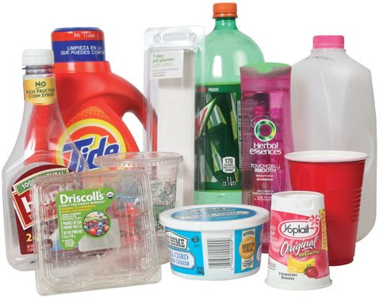
Plastics
Avoid as much as possible
a. Avoid Styrofoam (EPS)
b. Ditch Disposables
Recycle empty plastic containers
Notes:
Put lids back on

Slide 27
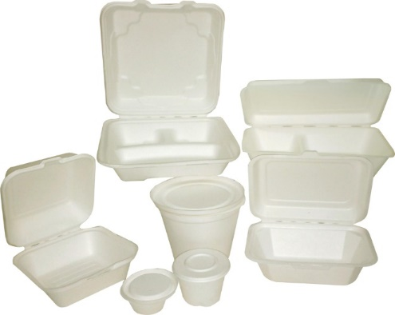
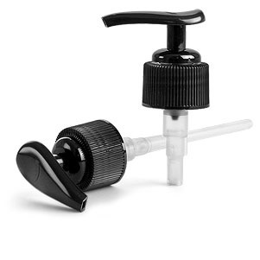
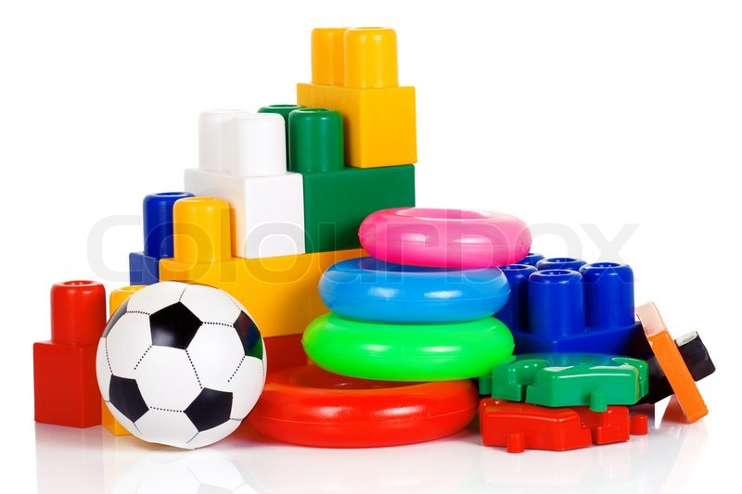
Plastics
What is NOT recyclable in the Blue Bin?
Plastic Bags/Films – some is recyclable at drop-off locations
Styrofoam – some is recyclable at drop-off locations
ACH & Marko Foam
Most plastic products that are not containers
Pump-tops (like shampoo or spray bottles)
Vinyl - (Air mattresses, pools and pool toys)
Hoses
Items smaller than 2”-3”

Slide 28
What is Recyclable in the Blue Bin?
Paper- No Shred
Cardboard- Clean & Dry
Cartons- No Tetra Paks
Aluminum/Steel Cans
Empty Plastic Containers- Caps on Bottles
Notes:
Recap

Slide 29
Common Mistakes
Plastic wraps/films
Glass
Vinyl
Mixed materials
Cloth
Filters
Chip and Candy wrappers
Napkins, toilet paper, paper towels
The Worst of the Worst:
Hazardous
Potential to contaminate (Liquids, Foods, etc)
Notes:
Ok, Lets talk about what is not recyclable in the blue bin.
I’ve highlighted the first two because they are highly recyclable items, and we will talk about them in the next slide, but here we are just define the SLC and SLV ‘blue bin’ collection rules.
Rules of Thumb; we have heard ‘when in doubt leave it out’ and ‘when in doubt give us a shout’. But with these rules of thumb, combined with knowing materials, you can pretty much know what is and is not recyclable in the blue bin. (But please always feel free to give us a shout)

Slide 30
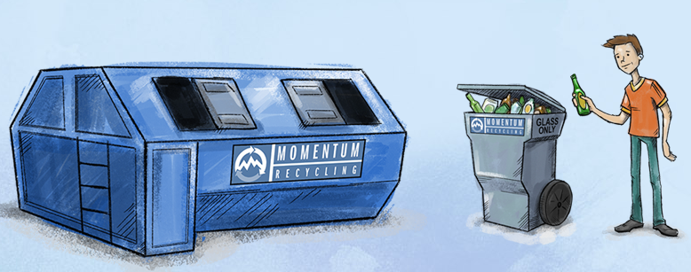
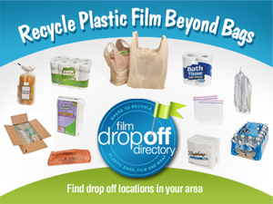
“Harder”- to Recycle Materials
Glass
Plastic Films
Autos
Batteries
Building Materials
Carpet Pad
Electronics
Mattresses
Propane tanks
Refrigerators
Scrap metal
Packing Peanuts
Textiles
Tires
https://slco.org/recycle/hard-to-recycle-items/
Notes:
Other Recyclables ,not accepted in curbside pick-up.
GLASS – Momentum offers low cost glass recycling pick-up for residential and businesses. They operate locally
Plastic Films – 1st reduce, then re-use and/or recycle. Plastic films are problematic for landfills, for MRFs that accept single stream recyclables, and for the environment. As Mercedes talked about, plastic bags can be returned to most grocery and department stores…
Other – these should not be termed ‘hard-to-recycle’ items anymore…..maybe not as easy as throwing it in a bin at home… but when waste diversion is added into the equation these are relatively easy… we have resources to collect them.
I removed some items from a typical list of this sort…I tried to differentiate between ones that actually get re-used or recycled vs materials that require proper disposal (prescriptions, chemicals, etc…..).
Which is a whole other topic

Slide 31
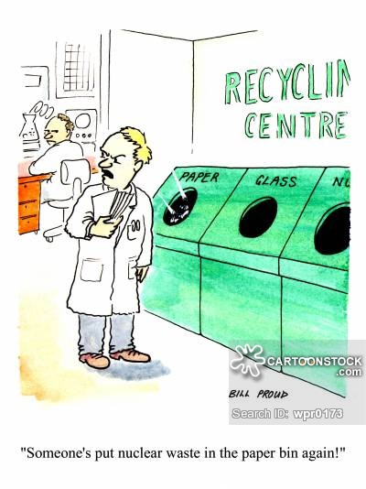
Challenges
Industry
Perception
Availability
Notes:
Alright, Challenges to recycling. We are going to talk about:
Challenges to the recycling industry
Perceptions that negatively effect recycling and recycling behaviors
Areas where availability is a challenge to recycling.

Slide 32
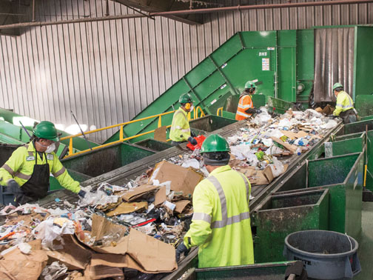
Industry Challenges
New packaging materials
Light-weighting
Commodity prices
Contamination
National Sword Policy

Slide 33
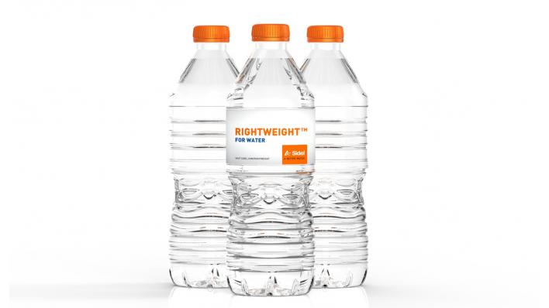
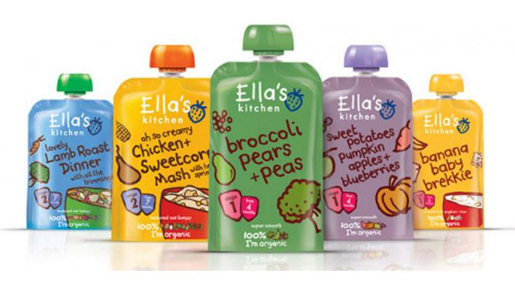
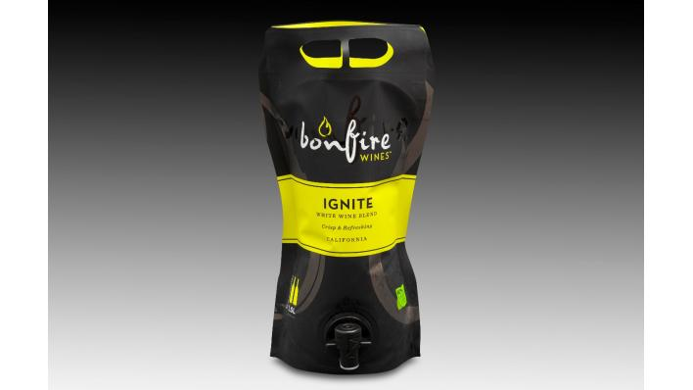
Lightweighting Packaging
“Food and beverage manufacturers have been placing increasing emphasis on reducing the packaging weight for the benefits of promoting environmental sustainability and reducing costs throughout the supply chain. This practice is known as “lightweighting.”
-Packaging Digest
Notes:
So this is good right? Depends on how you look at it. While we may use less raw materials to create these products they can actually be a source of contamination in our recycling stream. These plastic bottles that are being made with less plastic when crushed and sorted at a MRF can often be read by machinery as a thin piece of paper rather than a plastic bottle and wind up in the wrong bail. With new technology at the MRF opening in 2020 this may change but for a lot of facilities it’s still a problem.
Light-weighting, reduces transportation costs. But then, that introduces a very interesting dynamic for the industry because while processing costs are based on volume, the price they get for the commodity is based on weight. So they are dealing with the processing costs of high volumes of all this light-weight material but getting less money due to the weight.
Another good thing to note is:
With new packaging -designers and engineers are generally not working with Recyclers and don’t always design with the current
‘recyclability’ in mind.
For example – Costco’s large black plastic trays (vegetable trays) aren’t recyclable – not because of the material on this but because of the shape and design – their machinery just spits it out.

Slide 34
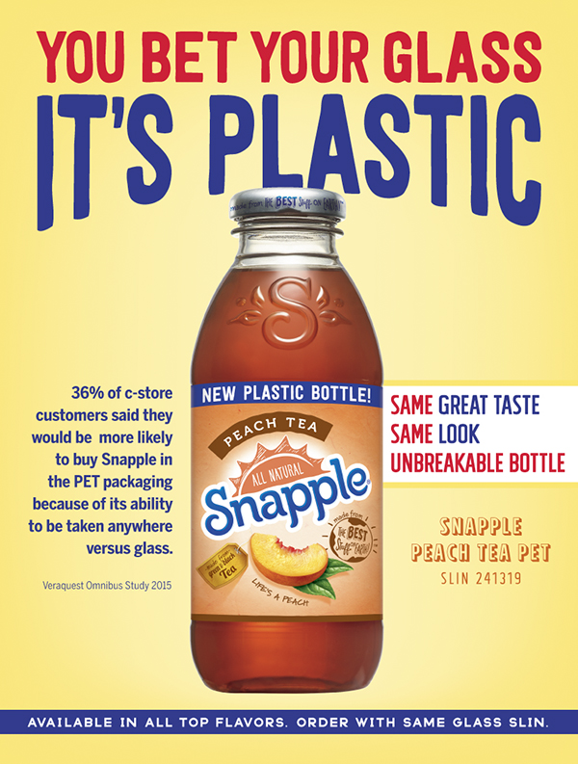
Notes:
Unveiled in February of 2018 Snapple switched from glass to plastic bottles. Marketing the difference between the two as -almost indistinguishable. The idea that now you can take it anywhere and it wont break.

Slide 35
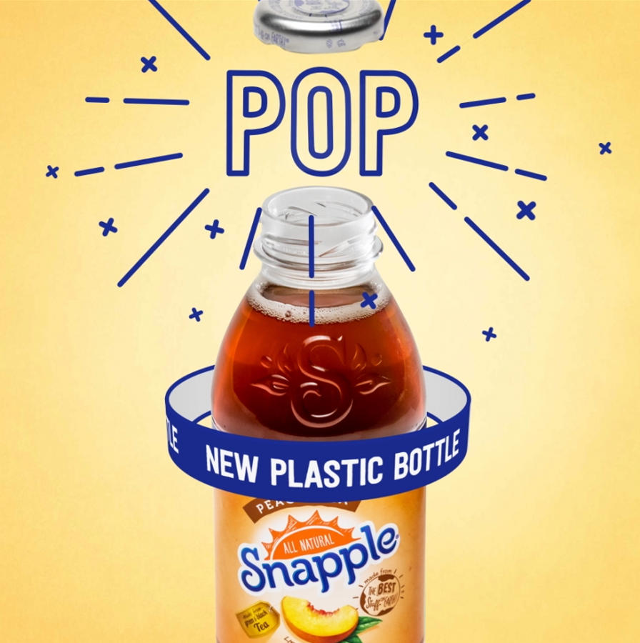
Notes:
Kept the metal lid for that pop- which consumers associate with freshness. “Snap” of Snapple. They went through all sorts of manufacturing problems to figure out how to keep the metal lid for a plastic bottle.

Slide 36
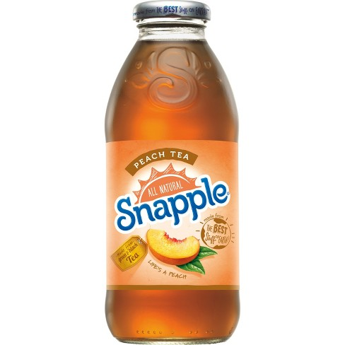
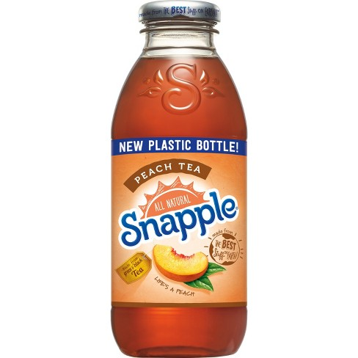
Notes:
Indistinguishable difference of glass/plastic bottle. Kept the thick walls so it has the hefty feel of a glass bottle but weighs 80% less.
We went from glass which is infinitely recyclable to plastic which is not and could end up in the ocean.

Slide 37
Industry Challenges
New packaging materials
Light-weighting
Commodity prices
Contamination
National Sword Policy
Notes:
Prices within the recycling market are constantly fluctuating.

Slide 38
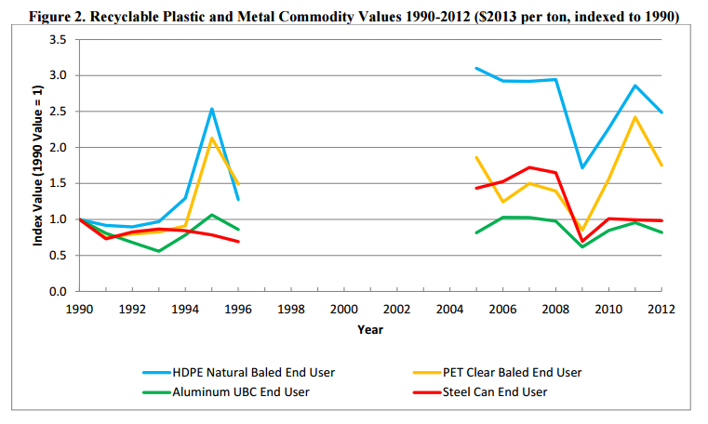
Notes:
One of the biggest challenges for Recyclers is commodity prices.
Commodity prices change for a variety of reasons – there are currency fluctuations, overages and shortages in certain material markets, labor issues/ strikes, etc. This graph is a little older but it shows how drastically commodity prices can vary which makes it very difficult to operate a business when you are counting on materials being worth a certain amount.
A good example of this is when the price of oil is low, it is cheaper for some manufacturers to build new plastic bottles than to recycle them and make new ones. Another is recycled container board used to trade in 2012 ish for $1,000 a metric ton. In 2015 it was at $400 a metric ton.
Foreign currency fluctuation, and the strength of the U.S. dollar means that our materials are more expensive abroad.
This matters because up to half of US recycled materials are exported or were.
EPA - https://www.epa.gov/sites/production/files/2015-12/documents/historic_tipping_fees_and_commodity_values_02062015_508.pdf.

Slide 39
Industry Challenges
New packaging materials
Light-weighting
Commodity prices
Contamination
National Sword Policy
Notes:
Contamination can affect what is accepted and at what price it is accepted.

Slide 40
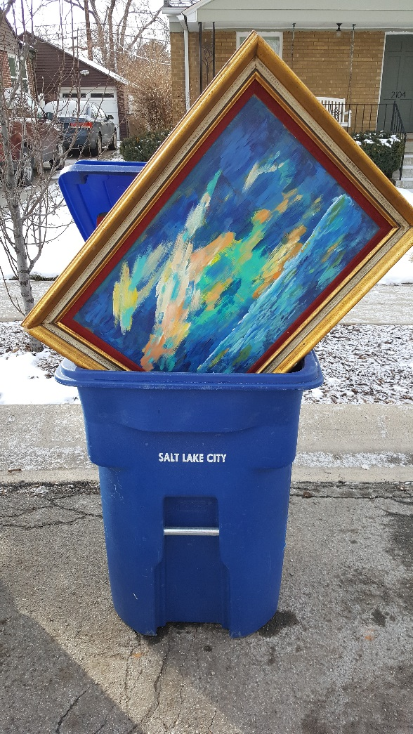
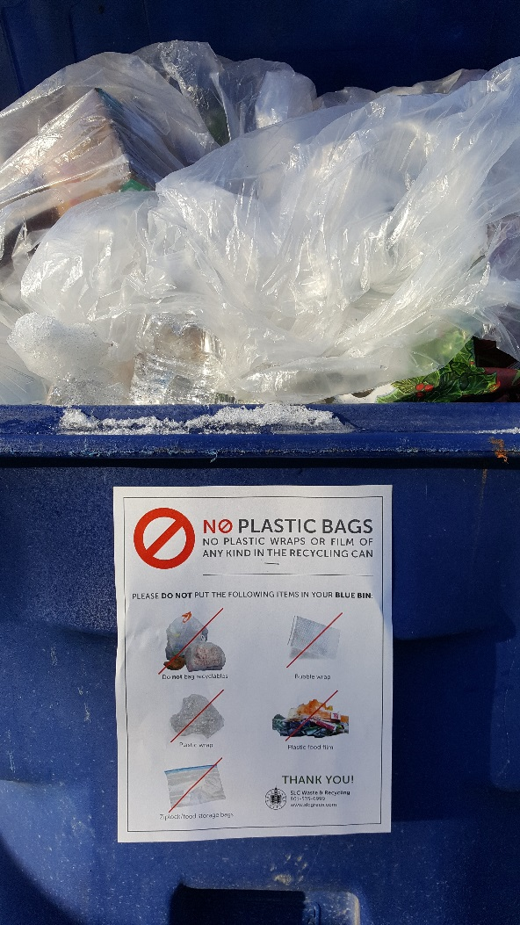
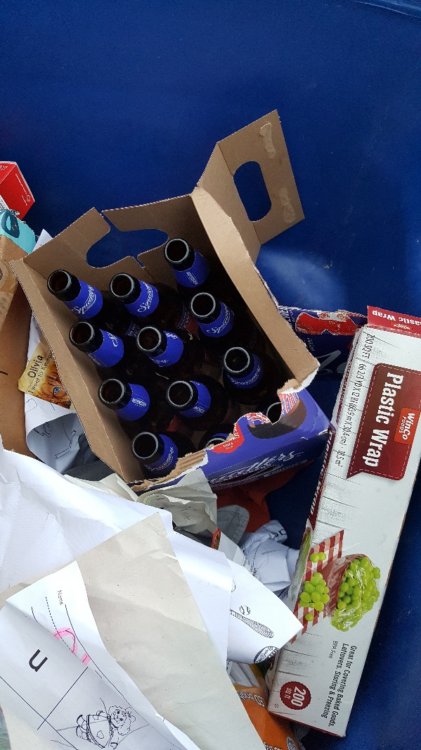
Contamination
Notes:
What can you do to help? Keep those contamination items out of your blue bin. If it’s something you’re not sure about, just ask. Since this is an industry that does change frequently from all the issues we’ve discussed it’s good to keep yourself up to date. As they say change is inevitable. The city has plenty of resources available on the SLC Green website or you can give us a call - “when in doubt give us a shout”

Slide 41
Industry Challenges
New packaging materials
Light-weighting
Commodity prices
Contamination
National Sword Policy
Notes:
Newest policy to affect the recycling industry.

Slide 42
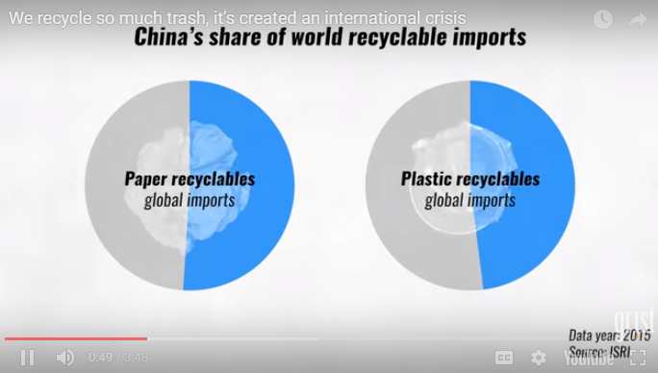
https://grist.org/article/we-recycle-so-much-trash-its-created-an-international-crisis/?utm_medium=email&utm_source=newsletter&utm_campaign=daily
Notes:
The U.S. exports about one-third of its recycling, and nearly half goes to China or was going to China until the beginning of 2018.
Because China holds a dominant position in global manufacturing. The US and many more developed countries send our recycled materials to China in shipping containers and often times the goods and products that they make were getting sent back in the same containers that we shipped the materials to them in.
https://grist.org/article/we-recycle-so-much-trash-its-created-an-international-crisis/?utm_medium=email&utm_source=newsletter&utm_campaign=daily.

Slide 43
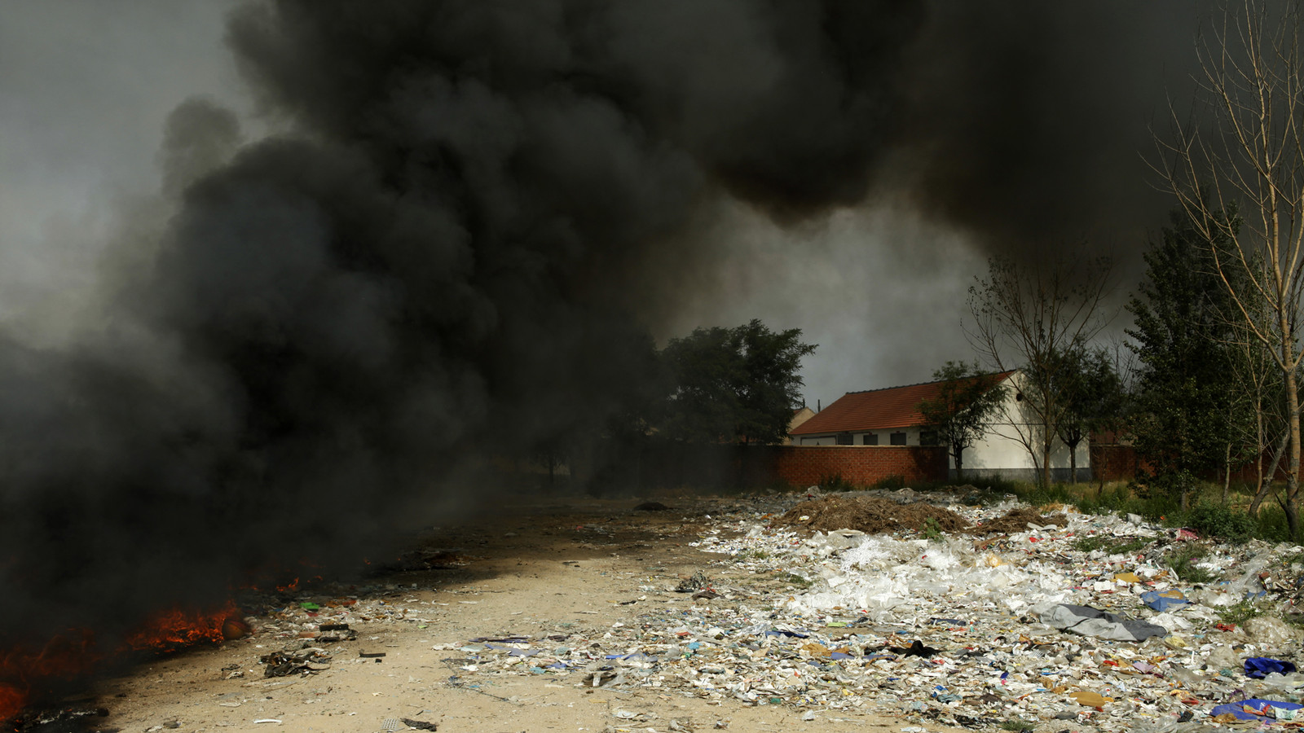
Notes:
All part of the bigger picture of China’s environmental initiatives and not to be taking in other countries waste.

Slide 44
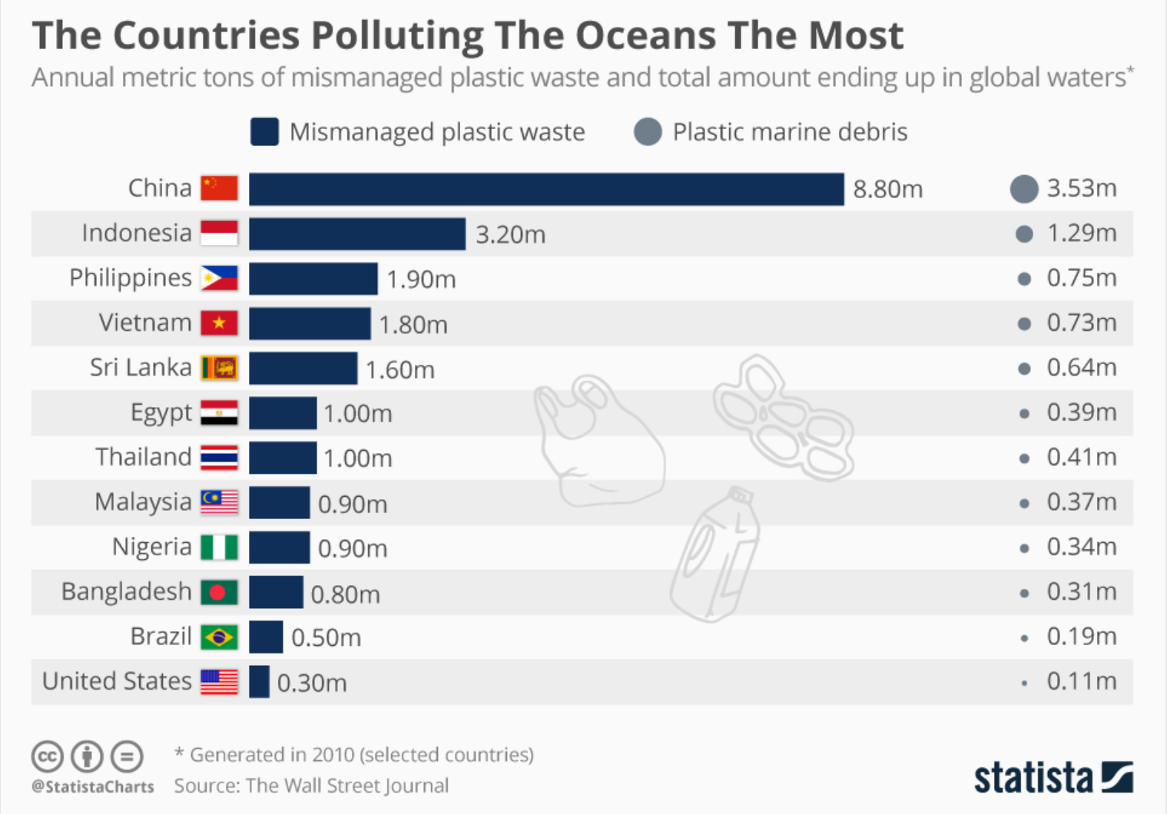
Notes:
Looking at our oceans and trying to combat things such as the Great Pacific Garbage Patch here are some of the major contributors to ocean litter.

Slide 45
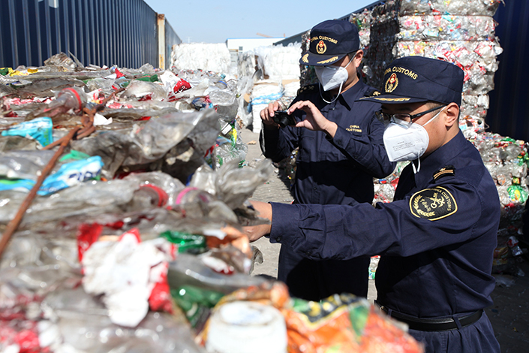
Notes:
In 2017 China implemented what they call the “National Sword Policy” strictly enforcing that bales of recycled materials had to contain less than .5% garbage in them. Prior to this, the industry standard was 4-5% contamination but in actuality they were allowing 10-20% contamination.
Going from 10 – 20% all the way down to .5% effectively stopped all of our “blue-bin” recyclables from being sold to China because processors could not get the stream that clean with how we have been used to recycling. It was kind of like well we’re not sure if this is recyclable so lets throw it in and no one was saying no…
China says the National Sword program is meant to eliminate or cut down on low-quality shipments received from poorly run facilities, household waste, undesirable plastic waste and electronic waste. Anything low-grade quality is taking a massive hit these are our number 3-7 plastics, while those exporters who focus in high quality plastics, numbers 1-2 may notice substantially less pain from this legislation.
This poses big risks for 1. Shippers - anyone caught shipping substandard material could have their licenses revoked. 2.Recyclers are at risk as they could face the financial burden of paying for the return of the bales. So Recyclers have to put more time and money into making sure the recyclables aren’t contaminated but don’t receive any more money for the goods. In fact, this also made domestic commodity prices drop because the market was suddenly flooded with these bales that were previously being sent to China.
Additionally, some U.S. plastics buyers—those who take mixed plastics bales—are charging to accept them, versus buying them pre-Sword legislation.
Unfortunately, this caused some recycling processing plants to shut down. For instance, the largest recycling hauler in the U.S closed 25% of their recycling plants. In the state of California (a state known for its progressive recycling), more than 450 recycling plants had been shutdown since February of 2018.
Everyone is scrambling to find new buyers, other than China as this has become the new reality.

Slide 46
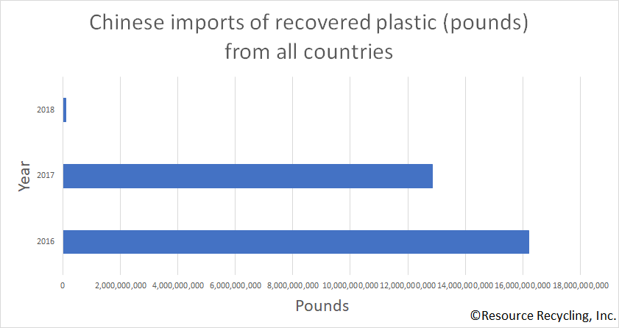

Slide 47
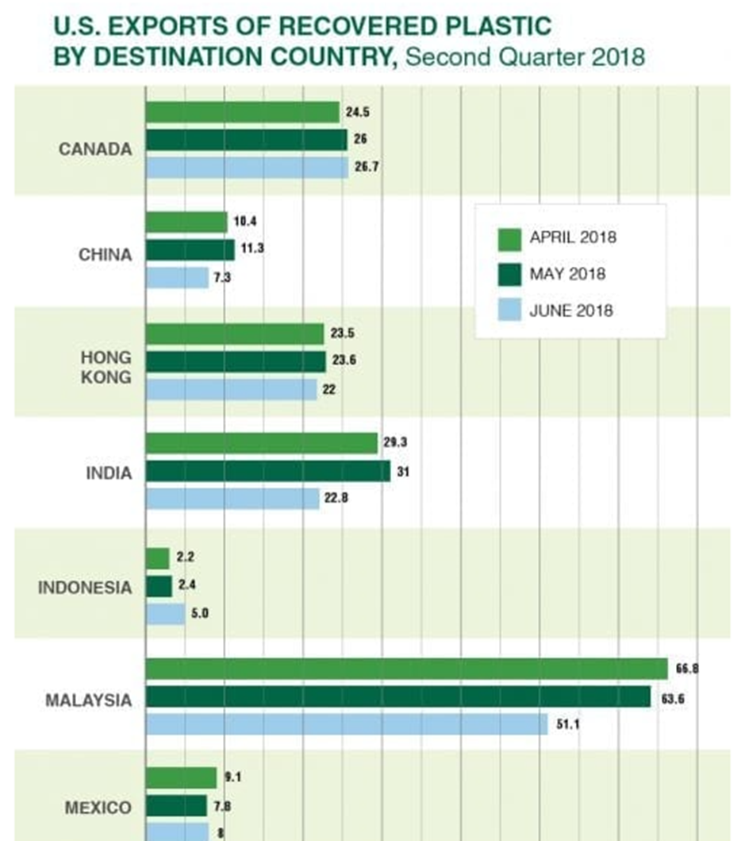
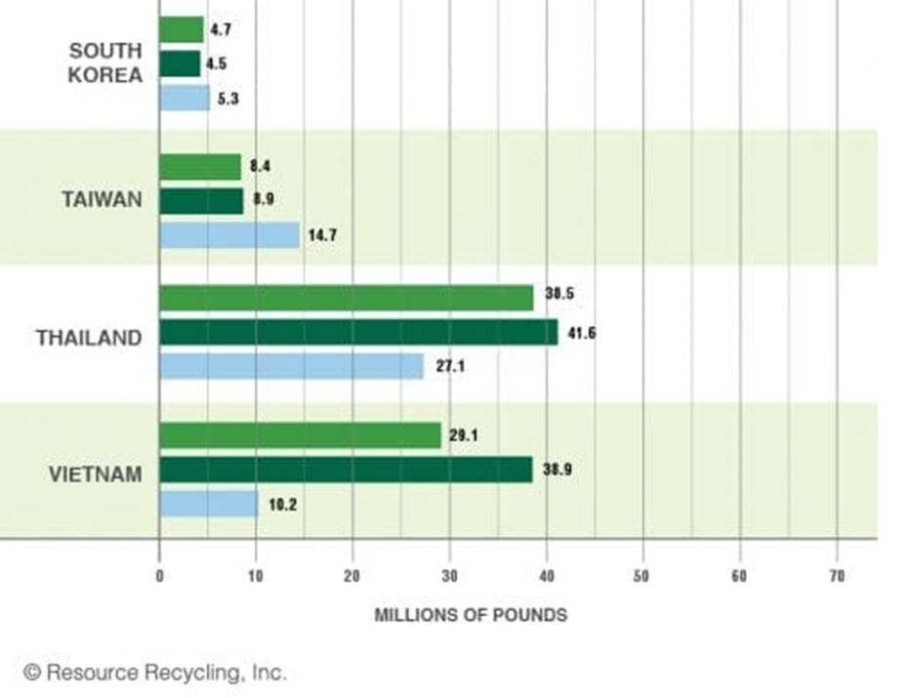
Notes:
A lot of this has changed. India.

Slide 48
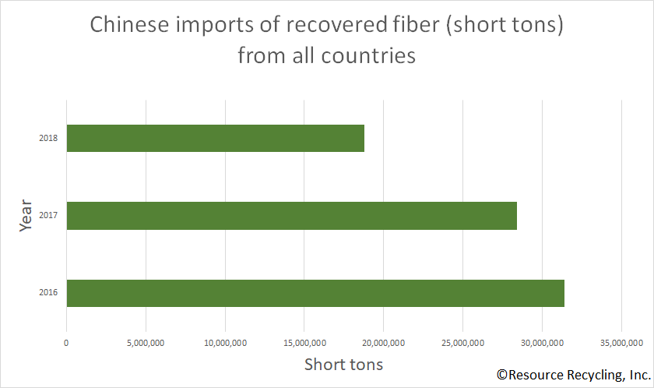

Slide 49
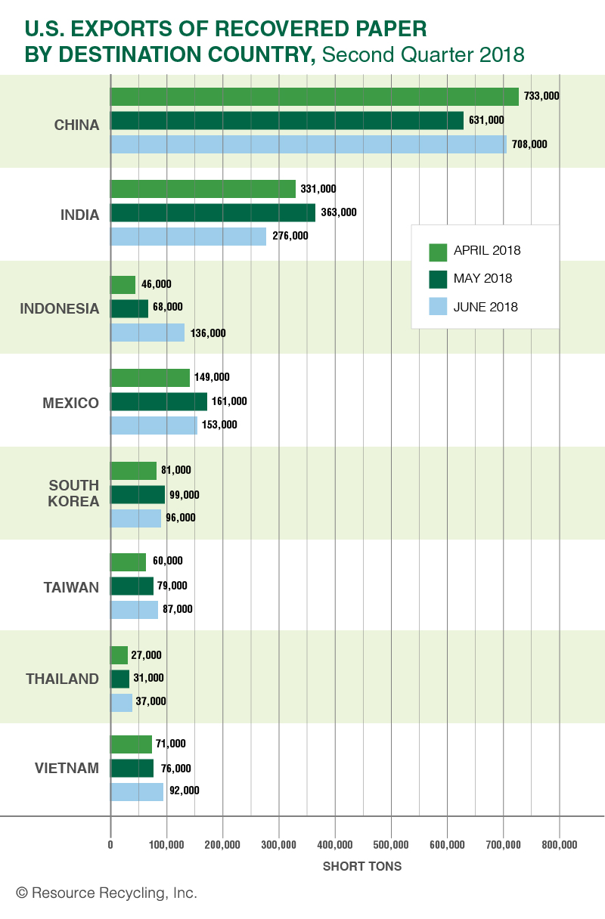

Slide 50
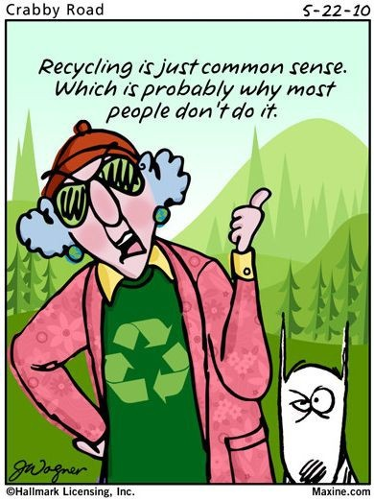
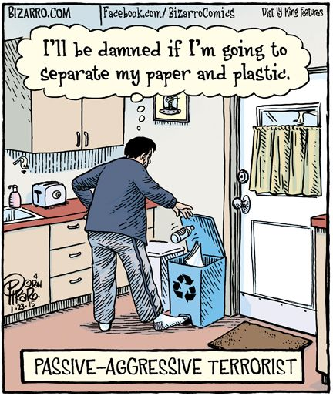
Perception Challenges
Waste is a ‘right’
Materials don’t actually get recycled
Government makes money from recyclables
People feel they have no control
responsibility is with government and manufacturers
No one else is doing it
It all gets sorted by someone else
Aspirational recycling
Recycling is confusing
Notes:
Many people think that their waste is a constitutional right, up there with a right to bear arms.
There are also several recycling ‘myths’ which have persisted and negatively
impact recycling
1 in 3 do not believe the council recycles all of
the materials collected, while many also believe that recycling costs less and that we are making a profit off recycling. Right now the numbers are moving on a monthly basis depending on “stream value” which is determined by contamination, market values, and stream make up but we are currently paying to have our material processed rather than getting paid for the material we provide.
An additional barrier is that the public feels they have little or no control over waste minimization and consequently place the responsibility firmly with the Government and manufacturers;
No one else is doing it – I want us to take a look at this cartoon here. I am sure it was well intentioned by the artist but the problem is that 1. The statement is false – most people with access to curbside recycling, recycle at least a portion of their waste stream – maybe they could be better at getting all their recyclables, but in general they do participate. But the big problem here is that it is ‘undermining the norm.’ Norms are the #1 biggest predictor of human behavior. We wear clothes because that is the norm, we behave in a certain fashion because that is the norm. And so when we undermine the norm it causes people to think “well others aren’t doing it, but at least I put some boxes in there’ or ‘everyone else isn’t doing it why should I have to.”
It all gets sorted by someone else – I ran out of room in my garbage can (which should almost never happen) but this all gets sorted anyway so it will be ok. Or, well parts of this item are recyclable – its mostly plastic – they will sort this out. –Mailing envelopes
Aspiration recycling – AKA wishcycling -this should be recyclable so I’ll put it in (we are all guilty of this one I would imagine) I hear so many times, “well it’s plastic why can’t you recycle it.”
Recycling is confusing – leads to people either not doing it or going back to aspiration recycling – it’s too hard. When out in the field I hear a lot of people say well what do you recycle any more? It’s not even worth it. Or they recycle only what they know for sure – a lot of bins with just cardboard.
What else? – Time, I don’t have time to sort the recyclables. I have a busy life and it is just not convenient for me.
2 in 5 people say that they are too busy while a similar proportion do not think recycling fits easily with their daily routine.
In the absence of a strong recycling culture, convenience becomes one of the key drivers of recycling behavior.

Slide 51
Perception Challenges
Notes:
A study conducted through a partnership with Utah State University, and the University of Notre Dame, found that men are less likely than women to engage in sustainable behaviors such as recycling in order to "safeguard their gender identity."
Previous research indicated being environmentally-conscious is "associated with femininity," so these researchers designed a series of experiments to test male behaviors.
Some of the results found that:
men are more likely to donate to environmental organizations with a masculine logo
men are less likely than women to buy products marked as "green;" and
both men and women perceive consumers who recycle or buy green products as "more feminine.“
It was also found that men are equally likely to avoid "green" practices both in public and private

Slide 52
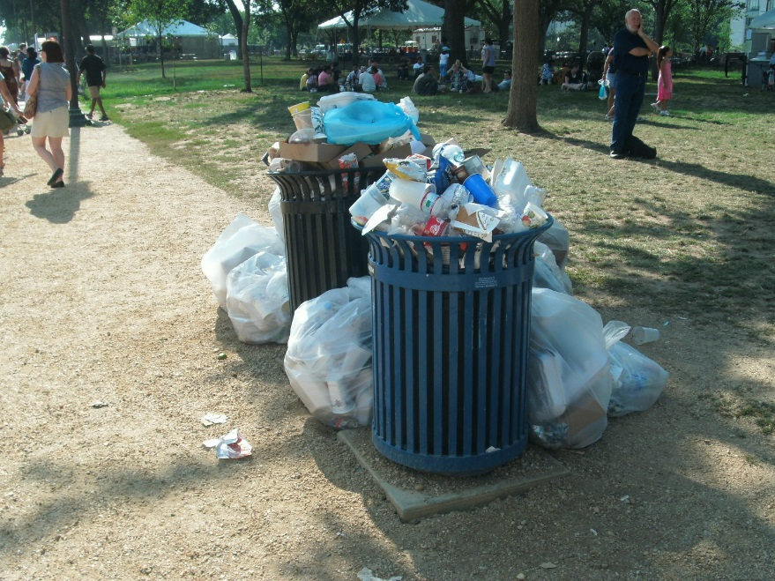
Availability Challenges
Public spaces
Apartments
Businesses
Rural areas
Space inside the home
Excess waste
Notes:
Each one of these could be broken down into sub-categories too.
Public spaces – not always provided in parks and other public spaces – some situations make it more inconvenient to carry the recyclable with you until you find an appropriate container.
When it is provided, I have seen the garbage can and recycle can look exactly the same so I wonder if it is going to be recycled at all because of the high contamination level.
Apartments – not always provided
sometimes more difficult to get to
can also be contaminated
Businesses – not always provided to the public – its hard to talk to customers about their recycling habits when it is important to make them happy and get repeat customers.
Rural areas – the more rural of the area the harder it is to recycle because it is not often provided in a curbside collection service. They may have to drive even the basic recyclables to the nearest drop-off site
Space inside the home – this is actually something that many households that don’t recycle well bring up. It is easy for me at my house because I am just one person and I have a little corner of my kitchen dedicated to the different materials. Not everyone in the household is on the same page. Sometimes there are several families living in the same home and it is not uncommon to see an overloaded garbage can and a highly contaminated recycling can.
Space on the property for more than 1 recycle or yard waste can.
Excess waste – a study in the UK found that most homeowners were more concerned with the ‘tidiness’ of the home rather than making sure the materials were going to the right place.
One example I see a lot here is where people will fit as much of their yard trimmings into the compost can as possible but will put the rest of it wherever else it will fit just to have it ‘gone’ instead of waiting for space in the right bin or taking it a diff collection point. Also you will see a really good recycling can and then whoever is taking them out to the curb has one last bag of garbage to throw in and they are not paying attention and they throw it in to the recycling bin. I’ve even had someone tell me it was hard to distinguish between the colors when it’s dark out.
Excess waste also leads to contamination. There are many times when I will move a plastic bag to the garbage can and then when I lift up their garbage can lid I see plenty of cans and bottles that could be recycled.

Slide 53
Green Purchasing
Notes:
Green purchasing also known as Environmentally Preferable Purchasing (EPP) –is generally defined as purchasing a product that has a reduced negative effect or increased positive effect on human health and the environment, when compared with competing products that serve the same purpose. Takes into account everything from the raw materials being used to the manufacturing process, the packaging, the distribution, use, and reuse of a product, as well as the disposal. We go over ‘green purchasing’ more in the commercial waste reduction and waste audits class on the 21st but I do want to bring up some things:

Slide 54
Green Purchasing
Durable Goods
Sugarcane-based products (Bagasse)
Biodegradable/Compostable
Paper w/Recycled content
Paper
Plastic w/Recycled content
Plastic
Styrofoam
Notes:
There is a “Responsible Disposables” tier where the 1st choice would be to avoid disposables by using durable goods, ceramic, glass, metal and the absolute worst option would be Styrofoam – with options in the middle like paper above plastic and in both categories, paper and plastic made from recycled content. Which brings us back to the recycling industry.
2. There are some general resources out there when deciding what to purchase. We’ve all heard the terms Energy Star, Sustainable Forestry Initiative, and LEED.
3. The Federal Trade Commission – Shopping Green Website that defines a lot of the language we hear surrounding Green Purchasing such as Biodegradable, Ozone-Friendly, Non –Toxic.
4. We put a lot of materials into our Recycling bins but it is also important to be purchasing materials made out of our recyclables and in that way we ourselves are completing the circle and stabilizing the market.

Slide 55
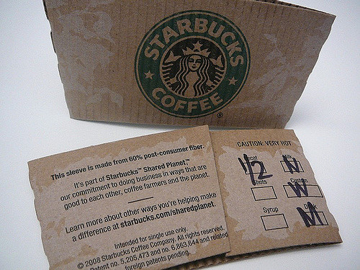
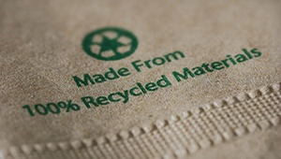
Recycled Content
Recycled vs. Post-Consumer Recycled
Notes:
SO, in buying products made from recycled content, it is important to understand the labeling.
When a product is made from pre-consumer recycled content, it’s made from manufacturer waste that never actually made it to the consumer for one reason or another.
A product made from post-consumer content is made from waste that’s been used by a consumer, disposed of, and diverted from landfills — stuff like the aluminum cans and newspapers that you place in your recycling bin for pick-up.
Then there are just “recycled content” products without either “PC” affix. This is just a catchall phrase. Something labeled as being made from recycled content could contain either pre- or post-consumer waste or a combination of the two. Generally, I’ve found that when a product contains high levels of post-consumer waste, it’s specified as so instead of generalized.

Slide 56
Pre- Consumer
Notes:
Pro Recycling Group – laundry detergent that discontinued the label so they could no longer use these containers.

Slide 57
Outreach Best Practices
Knowledge-Deficit Theory
When knowledge can be a barrier to recycling:
New Program
Changes in existing program
Complexity of Procedure
Motivation for Recycling
Norms
Convenience
Benefits
Financial (personal)
Social/Economic (local)
Environmental (local)
Notes:
There has always been this idea that if we just tell them or teach them about it…. They will be great recyclers. This is called the knowledge-deficit theory. But it has been proven that although there is correlation between knowledge and recycling behavior it is not a causal relationship.

Slide 58
Promoting Sustainable Behavior
-Berkeley Office of Sustainability

Slide 59
First it is vital to attract attention and keep it.
When people are listening make sure you use persuasive messages
and strategies to foster change.
Remember to keep an eye on your delivery and think carefully about your
audience.
https://sustainability.berkeley.edu/sites/default/files/Promoting_Sustain_Behavior_Primer.pdf

Slide 60
Don’t Undermine the Norm Be specific
Highlight the actions of others
Attract attention Use persuasive messaging
Consider your audience Paint a picture
Explain why you care Be knowledgeable
Use examples Appeal to self-interest Highlight losses over gains Tell a story
Appeal to Identity Ask big, accept small Make recycling a pleasant experience
Pick your moment
Be Nice
Notes:
Be Nice – a judgmental attitude, idealism, or superiority does not resonate well with anyone.
Lead by example, you cannot force people to recycle and expect a good long term outcome. They have to want to do it on their own, we can just provide a bounty of reasons why it’s important.

Slide 61
Thank You
Helpful Links
https://napcor.com/
https://www.consumer.ftc.gov/articles/0226-shopping-green
https://utah.momentumrecycling.com/
https://www.springbackutah.com/
https://grist.org/article/we-recycle-so-much-trash-its-created-an-international-crisis/?utm_medium=email&utm_source=newsletter&utm_campaign=daily
https://slco.org/recycle/hard-to-recycle-items/
Questions?

